Slide 1

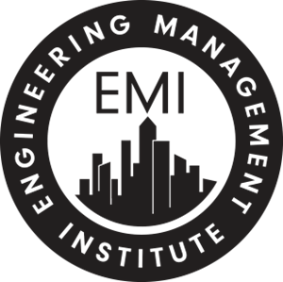
Time Management and Maximizing Productivity for AEC Professionals
Presented for
Custom Content Presented by
Notes:
https://www.surveymonkey.com/r/T&M-timemanagement
​[INSTRUCTOR 1/ANTHONY] [VIDEO ON]​
Hello, this is Anthony Fasano and I'd like to welcome you to the fourth skill building session of the “Engineering Leadership Accelerator - People Skills Course” entitled “Time Management and Maximizing Productivity”. ​
We’re all tight on time, running around trying to complete the hundreds of things on our to-do lists, however a great way to reduce stress and feel much more on top of your game is to spend some time on becoming more productive. To that end, I’d like to start this session with the following quote: [CLICK]​

Slide 2

PDH
The Engineering Management Institute (dba The Engineering Career Coach) has met the standards and requirements of the Registered Continuing Education Program. Credit earned on completion of this program will be reported to RCEP at RCEP.net. A certificate of completion will be issued to each participant. As such, it does not include content that may be deemed or construed to be an approval or endorsement by the RCEP.
Notes:
[VIDEO ON]
[ANTHONY/INSTRUCTOR 1] [BEGINNING SCRIPT]
Before we start, I want to let you know that we are members of the Registered Continuing Education Program (also known as RCEP) and this course is accredited for Professional Development Hours (PDHs) in all US states. If you are in New York, you should confirm that there is applicable, we have had scenarios where they do accept some PM concepts for PDHs and not others.
There are a few steps to obtain your PDHs:
One - attend the sessions (or watch the recordings)
Two -complete the evaluation emailed to you after the last session, and
Three - submit your completed workbook within 2 weeks of the last session.
We will remind you of this as we get closer.
[END SCRIPT] [CLICK]

Slide 3
Copyright Materials
This educational activity is protected by U.S. and international copyright laws. Reproduction, distribution, display, and use of the educational activity without written permission of the presenter is prohibited.© The Engineering Management Institute/The Engineering Career Coach 2024.
Notes:
[VIDEO ON]
[ANTHONY/INSTRUCTOR 1] [BEGINNING SCRIPT]
One other housekeeping note, all of the course materials are under Copyright by EMI, so we would appreciate it if you do not share them with people who are not enrolled in the course. If you’d like to discuss or teach the skills to your team members you certainly can, but we ask that you do not duplicate or distribute the course materials.
Now, let’s take a look at the topics we are going to cover together.
[END SCRIPT] [CLICK]

Slide 4
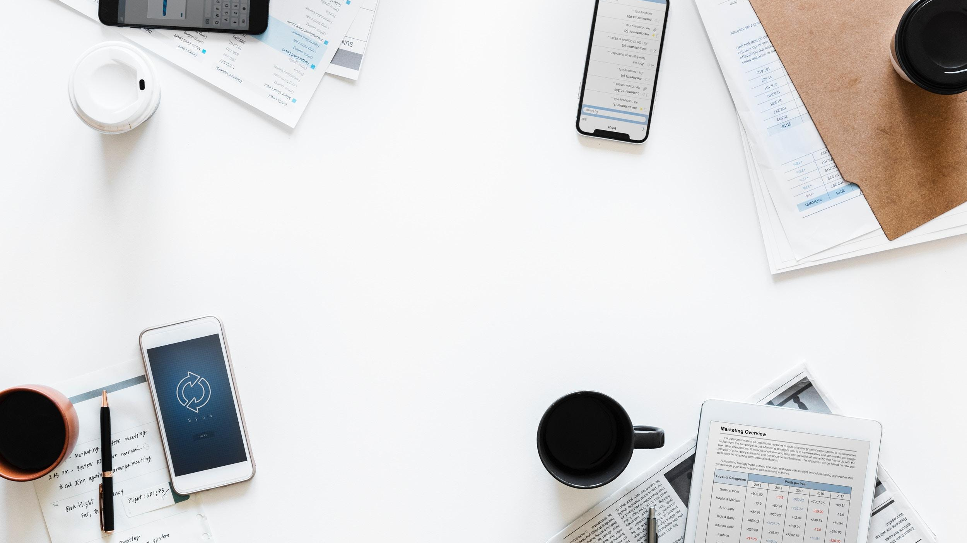
“Efficiency is doing things right; effectiveness is doing the right things.”
– Peter Drucker
Efficiency versus Effectiveness
Notes:
​[INSTRUCTOR 1/ANTHONY] [VIDEO ON]​
This is actually one of my favorite quotes of all time, from the famous management consultant and author, Peter Drucker: “Efficiency is doing things right. Effectiveness is doing the right things.” This quote, in my opinion, captures the reason that people run out of time every day. Its why people feel like they need help with their time management. The problem is they focus on the wrong things.
As engineers and technical professionals, we like to accomplish a lot every day. We like to feel efficient and check off a lot of items on our to do lists. That's something that makes us feel good, and productive, BUT a warning here, if you're not focusing on the high priority tasks, then this approach doesn't really help you, your team, or your company. At the end of the day, while you might feel good and efficient because you “got a lot done”, you have not been effective. [CLICK]​

Slide 5
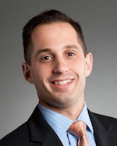
Introduction – Anthony Fasano, PE
B.S. & M.S. in Civil Engineering
Licensed Professional Engineer
Found success at a reputable firm at a very young age
Attended iPEC – the top ranked executive coaching school in the world
Wrote the best-selling book
Engineer Your Own Success and started providing career coaching and speaking services to engineers
Notes:
[ANTHONY/INSTRUCTOR 1] [VIDEO OFF]
Now, I’d like to introduce my co-instructor for today’s session, Erica Lee Garcia.
Erica has also had a successful engineering career. She is a professional engineer licensed in Ontario and British Columbia.​
She has a Six Sigma Black Belt, is Lean certified, and consults to clients in manufacturing, mining, and professional services​.
She found “Engineers of Tomorrow”, a national non-profit organization dedicated to inspiring and informing the next generation about engineering​.
She is dedicated to evolving the conversation within the engineering profession. In fact, she has also given some presentations for EMI around the topic of diversity & inclusion, specifically around women in engineering.
Erica, thank you for being with us today. I’d like to ask you to quickly say hello to our group here, and also can you quickly explain what Six Sigma Black Belt means.
[AFTER INSTRUCTOR FINISHES CLICK]

Slide 6
Learning Objectives
To give you a blueprint for increasing productivity and improving your time management. In this session, you will learn how to:
Apply the Pareto Principle (80/20 Rule) within your engineering projects and your personal routines
Create a specific approach to your day that will ensure that you focus on high-leverage tasks, increasing your productivity dramatically
Improve your overall time management efforts
Notes:
[INSTRUCTOR 1/ANTHONY] [VIDEO ON]
The purpose of this skill building session[click] is to give you a blueprint for increasing productivity and improving your time management. In this session you will learn how to:
[CLICK] Apply the “Pareto Principle”, also known as the “80/20 rule” within your engineering projects and your personal routines,
[CLICK] Create a specific approach to your day that will ensure that you focus on high leverage tasks, increasing your productivity dramatically, AND
[CLICK] Improve your overall time management efforts. [CLICK]

Slide 7
I’ve heard of it but I’m not familiar with it.
I’m pretty familiar with it.
I am familiar with and have used it before in my productivity measures.
I’ve never heard of it.
What is your knowledge of Pareto Principle
also know as the 80/20 Rule?
Notes:
[ANTHONY/INSTRUCTOR 1] [BEGINNING SCRIPT]
now we will open up a poll for you. so please take some time to input an answer in the chat or state verbally:
What is your knowledge of Pareto Principle also known as the 80/20 Rule?
I’ve heard of it but I’m not familiar with it.
I’m pretty familiar with it.
I am very familiar with and have used it before in my productivity measures.
I’ve never heard of it.
[interact with participant answers]
[click]

Slide 8



Three Rules to Maximizing Productivity
To achieve a focused, productive, and low-stress career and life overall, follow these three rules.
Stay Organized
Remain Focused
Reduce Stress
Notes:
[INSTRUCTOR 1/ANTHONY] [VIDEO ON]
We are huge proponents of frameworks at the Engineering Management Institute. In our Orientation, we covered a three-step process for goal setting, in our communication session, we covered nine strategies for effective collaboration, and in our last session we gave you seven actions to prepare for your next presentation. Frameworks make it easier to learn and practice a new skill. Therefore, in this session, we are going to cover three rules for maximizing productivity. [CLICK] Number one is to stay organized, number two, [CLICK] remain focused, and number three, [CLICK] REDUCE STRESS. ​
If you follow these three rules, [click] you can achieve a more focused, productive and lower stress career and life overall.​ [CLICK]

Slide 9


Rule #1
Stay Organized
Remain Focused
Reduce Stress
Notes:
[INSTRUCTOR 1/ANTHONY] [VIDEO ON]
Let’s start with rule number one, which is to get and stay organized. Sometimes staying organized is harder than becoming organized.​ [CLICK]

Slide 10

Physically Organized = Mentally Organized
Notes:
[INSTRUCTOR 1/ANTHONY] [VIDEO OFF]
Being physically organized helps you to be mentally organized, which means you’ll maintain a clear mind. For example, if you're surrounded by clutter on your desk, it may impact your ability to think clearly. If you have three hundred emails in your inbox, regardless of how un-important they are, they will certainly weigh on your mind and again reduce your ability to think clearly.​
So, what I'd like to do in this segment related to Rule #1 is give you seven specific strategies for becoming and staying organized.​ [CLICK]

Slide 11
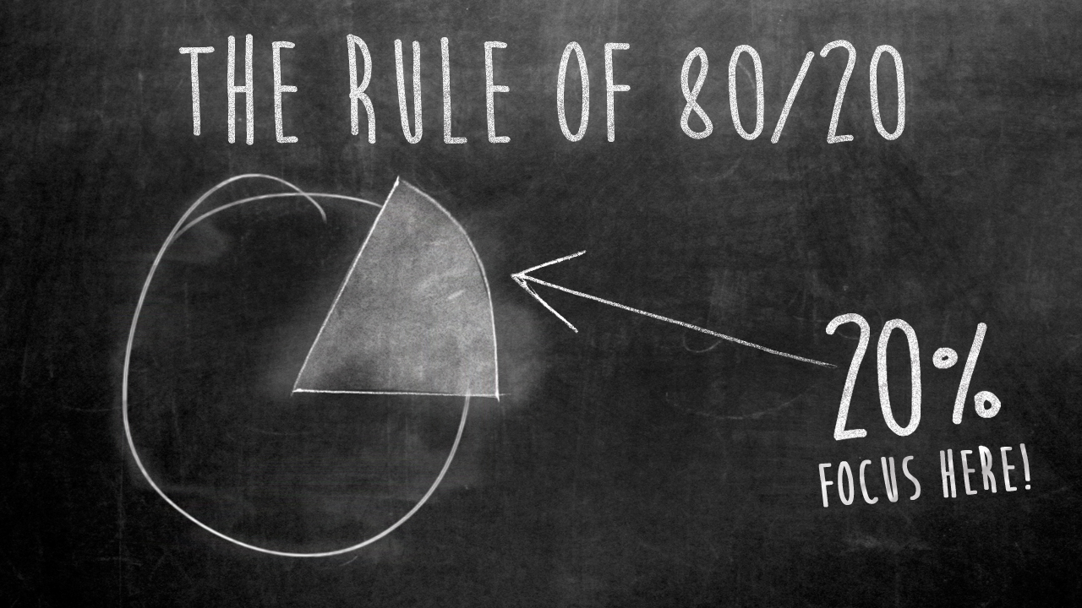
1.1 Deploy a minimalist mindset
Notes:
[ANTHONY/INSTRUCTOR 1] [BEGINNING SCRIPT]
One of the most important concepts in this session and maybe in this entire course, is to deploy a minimalist mindset, which will allow you to focus on what matters most. ​
And in order for me to stress the importance of this action, I must talk about the 80/20 rule of , which is a nickname for something called the Pareto Principle, which came from the research of an Italian economist Vilfredo Pareto in the late 1800s. ​Vilfredo Pareto was studying the distribution of wealth in the United Kingdom.
He noticed that roughly twenty percent of the people that lived in the United Kingdom possessed eighty percent of the money or the wealth.. Next, he decided to investigate land ownership in his home country of Italy. And he noticed again, approximately twenty percent of Italians possessed eighty percent of the land in the country. ​
He thought that this was a very interesting repeated pattern. Next, he looked at something that was much more mundane, like his own vegetable garden. And he noticed that approximately twenty percent of the garden yielded eighty percent of the vegetables. ​[CLICK]

Slide 12
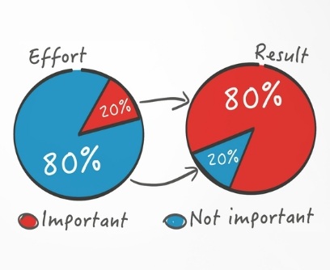
Notes:
[ANTHONY/INSTRUCTOR 1] [BEGINNING SCRIPT]
Now, it could have been 70/30 or even 65/35, but it was always close to an 80/20 split.​
He was finding this ratio everywhere and he essentially produced the Pareto Principle which is the law of the vital few, or the principle of factor sparsity. This rule states that, for many events, roughly eighty percent of the effects come from twenty percent of the causes.​
Let’s translate this law into something that you can use daily. Roughly eighty percent of the success in your career and in your life comes from twenty percent of your efforts.
Imagine you could just focus on the [CLICK] 20% of your efforts that are driving [CLICK] 80% of your results. It would be a game changer. I'd like to provide you with two examples of this, one professional, and one personal. [CLICK]

Slide 13
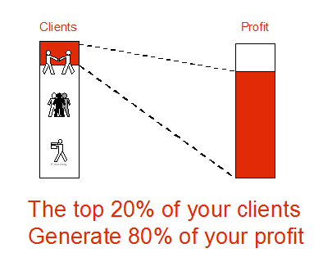
Notes:
[ANTHONY/INSTRUCTOR 1] [BEGINNING SCRIPT]
First, the professional example, roughly 80% of the profit that your company earns on an annual basis comes from 20% of the client base. It could even be in the 70/30 range, but you get the picture.​ Identify those clients in your head and focus on your interactions with them. [CLICK]

Slide 14

Notes:
[ANTHONY/INSTRUCTOR 1] [BEGINNING SCRIPT]
Next, from a personal perspective, I'm going to tell you a quick story about myself. I live in the Northeastern United States, where the seasons change dramatically. Typically, in the fall, my wife and I need to pull big trunks of winter clothes out of the attic, and we change out all our clothes.
We put all our sweaters and heavy clothing into our dressers and pack all of our summer clothes away, and then change them again in the spring.
Once I learned about the 80/20rule, I realized, I only wear twenty percent of my clothes, eighty percent of the time. It's completely true. We all have our favorite outfits. So, I took all of my clothes out, winter and summer, and I culled them down and donated a ton of clothes that I never wore. ​
And now, for the last five or six years, I fit all my clothes, year-round, in one dresser and in one closet and I never have to pull my clothes out of a trunk again. Now, my wife still does it and that's up to her. But I know that she only wears 20% of her clothes 80% of the time. ​
So, the point is that if you learn this rule and you apply it to your career, and your life, you will start to focus on the higher priority items and this mentality will change the game for you, forcing you to become a minimalist and focus primarily on what really matters.
Any questions on the 80/20 Rule before we go further?
[PAUSE AND WAIT/ANSWER QUESTIONS]
Richard Koch, K-O-C-H, is the go-to author on the 80/20 Rule, and I will give a list of books at the end of the session today on the different topics I will discuss.
[CLICK]

Slide 15

1.2 Organize your note-taking efforts
Notes:
[ANTHONY/INSTRUCTOR 1] [BEGINNING SCRIPT]
Number two, in terms of getting organized, is to organize your note taking efforts. Note taking is an area in which many engineering professionals are prone to disorganization. Notepads everywhere, sticky notes all over the office.
So, here are three things that you can do to take more organized notes. ​
First, use a bound notepad for all your notes and always keep it with you. This is simple and obvious, but a very powerful habit to build. If you have to go to a conference , or to a project site, or a coworker's office, keep this bound notepad with you. And always record your notes with a date and location making it easier to go back and find things.​
​
Second, use a digital notebook or note taking system like Evernote or OneNote, which allows you to share notes across different devices and with different people.
The third action is to eliminate sticky notes. Most of the time they are scattered and will scatter your thoughts. I've used sticky notes all over my monitor and my desk. However, now, I use them ONLY for very specific things like separating papers in a folder and labeling them or marking pages in a book, or if I want to leave a note for someone, I might put it on a sticky note and put it on a door, but NOT for taking important notes of any kind. ​[CLICK]

Slide 16
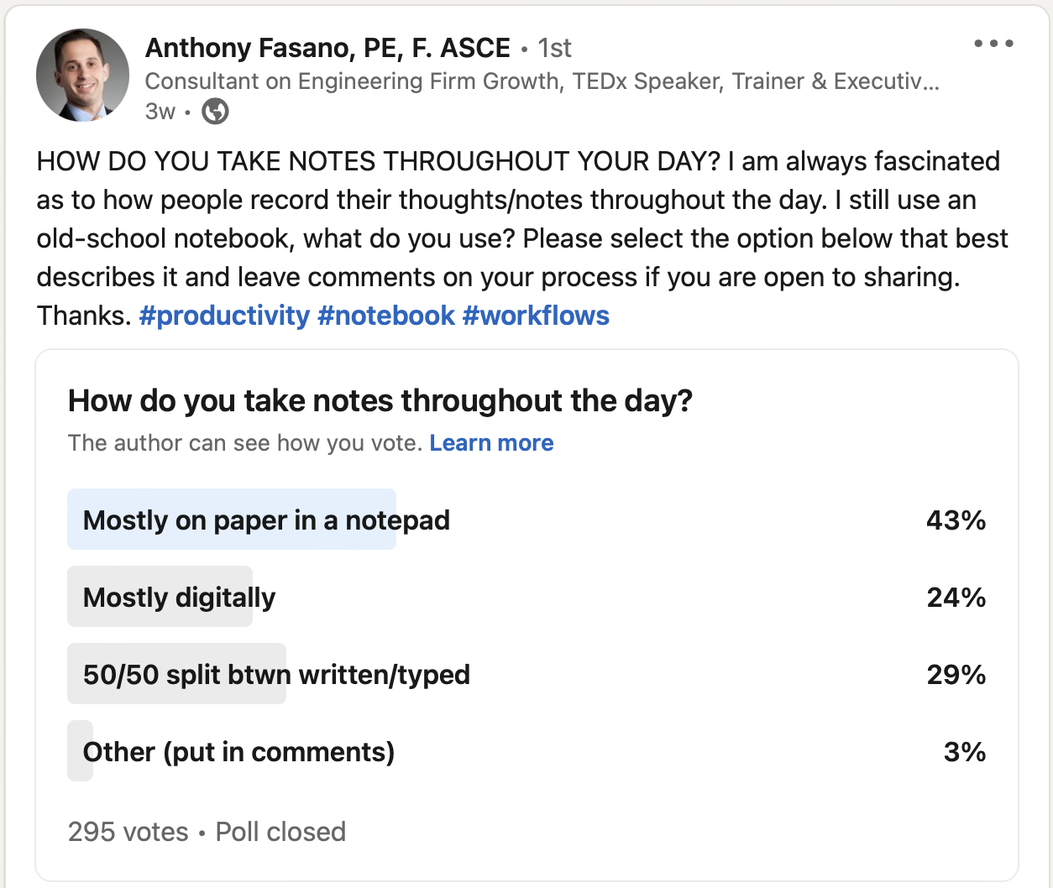
Notes:
[ANTHONY/INSTRUCTOR 1] [BEGINNING SCRIPT]
in fact, we took this topic to LinkedIn to ask some of our followers their opinions on note taking. What methods they prefer to use/ dont use and out of the 295 votes received 43% reported that they record on a notepad. while 29% record notes digitally, it could be a bit challenging to stick to that method solely.
[click]

Slide 17
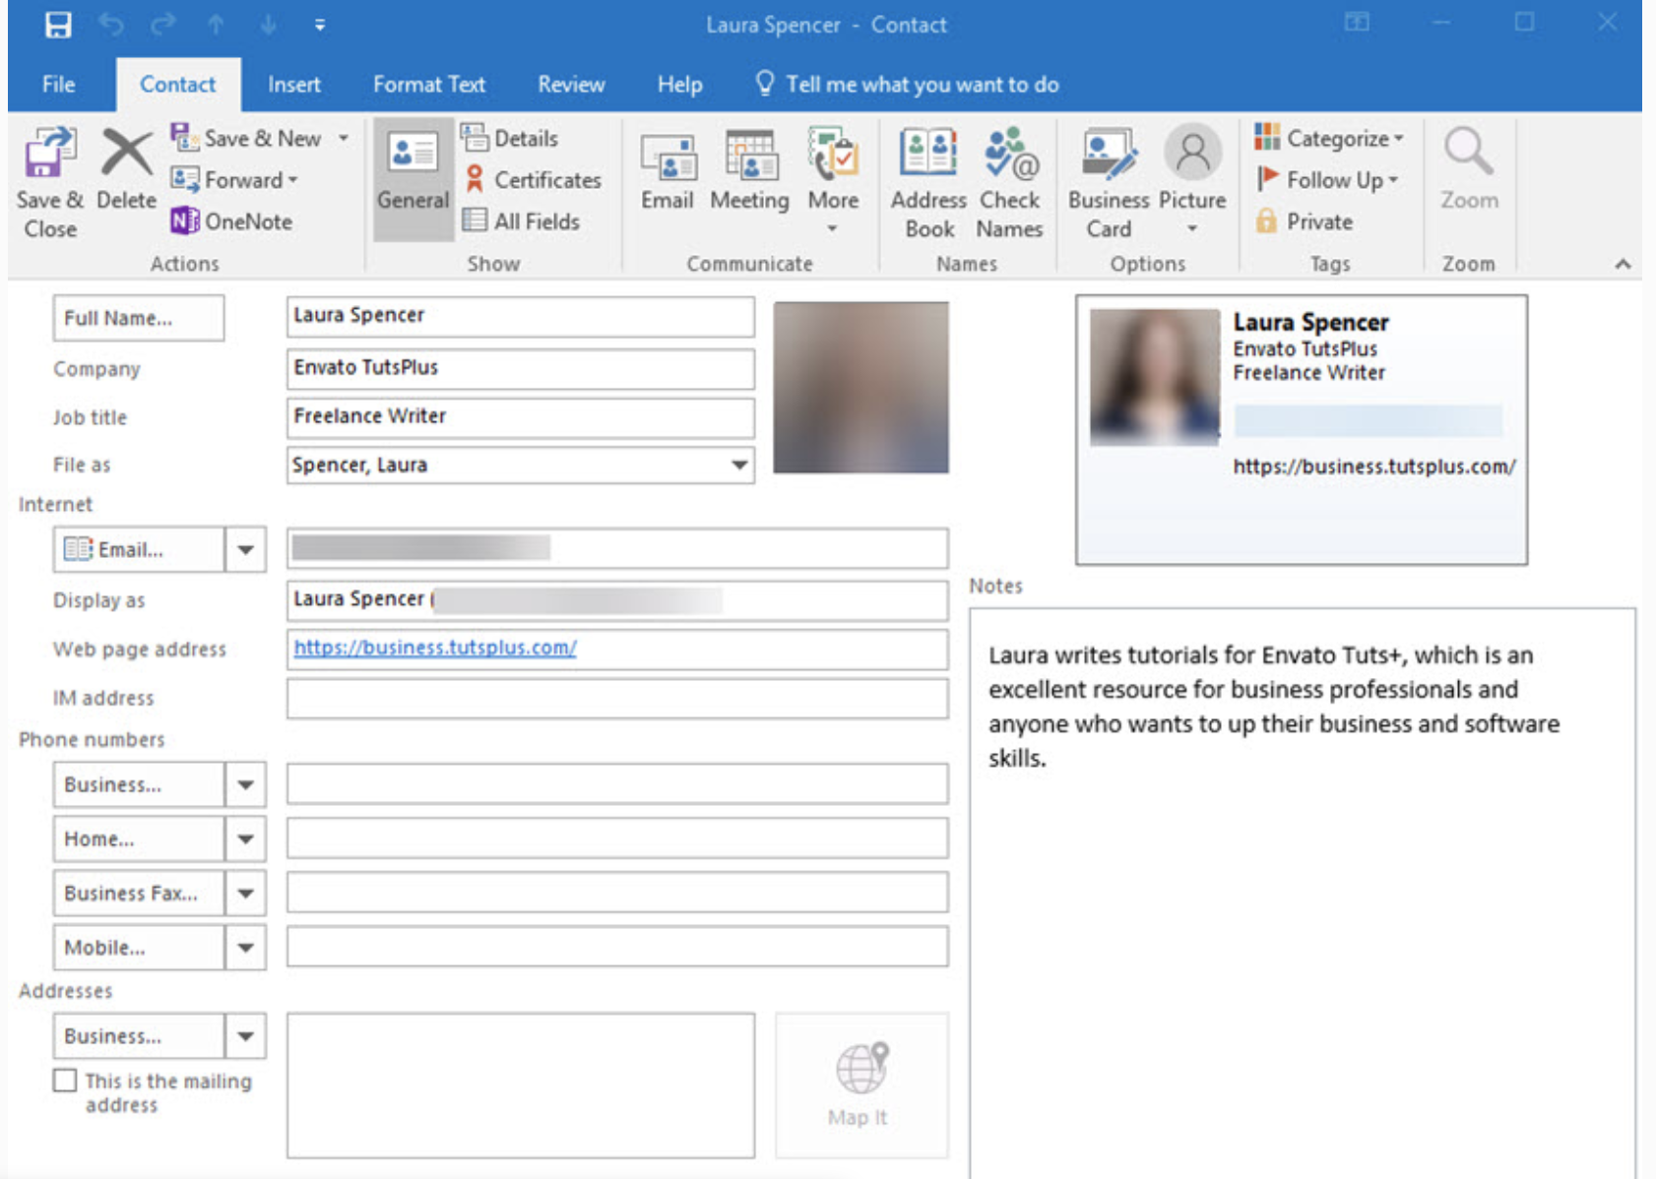
1.3 Manage your contacts effectively
  “Relationships are your lifeline!”
Notes:
[ANTHONY/INSTRUCTOR 1] [BEGINNING SCRIPT]
Number three in terms of getting organized is to manage your contacts effectively. ​
Regarding managing your contacts, the first thing you must do is ensure that you have an effective system to organize your contacts. You can see a screenshot of Microsoft outlook on this slide, that is a great tool to organize your contacts. ​
Some people like to use LinkedIn or Gmail, I just recommend you choose an online tool which is accessible from your mobile device, should you need to reach someone from out of the office. ​
You can also apply the 80-20 rule to your contact management by making it easy to access the people that you contact 80% of the time. This will undoubtedly make life easier. ​
For example, people you communicate with regularly like your manager, or your spouse, should go into your contact database with short codes for dialing. For example, you can pick up your phone and press the number 1 and your manager will be dialed. Shortcuts like this can save you a lot of time. ​
It's also important that when you meet people for the first time, you enter their contact information into your database as soon as possible and minimize that lag time between making the contact and entering their information into your system. ​
You want to make sure you don't lose their information.. Physical clutter leads to stress, so populate your system and throw out the business cards or put them in a binder somewhere. Otherwise, they're going to pile up on your desk and add to your stress. ​
[CLICK] Remember, your relationships are your lifeline, so managing these contacts are critically important. ​[CLICK]

Slide 18
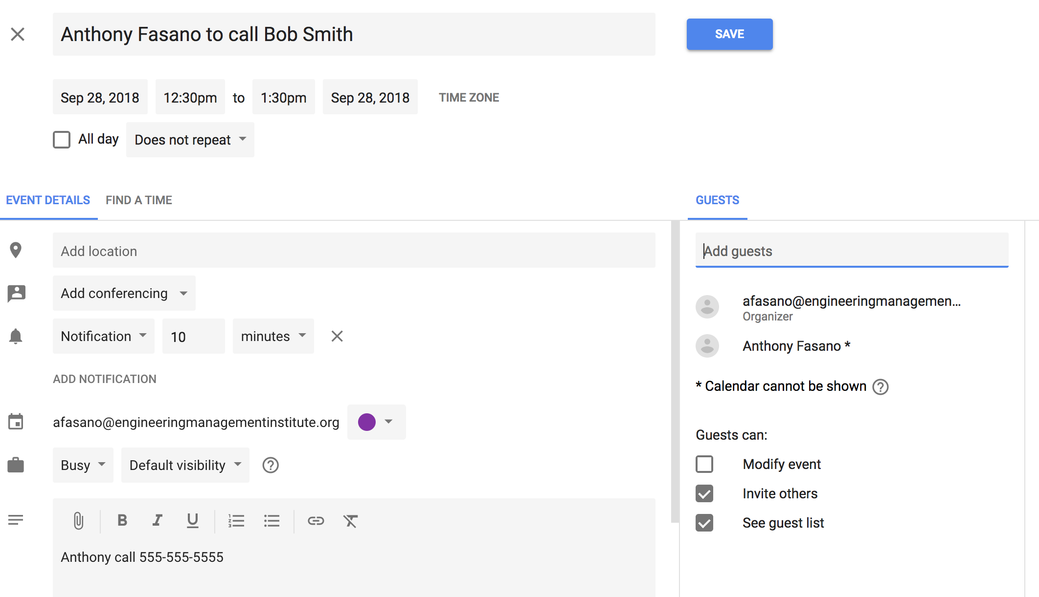
1.4 Organize your appointments
Notes:
[ANTHONY/INSTRUCTOR 1] [BEGINNING SCRIPT]
Number four, organize your appointments. This is another underrated action that definitely contributes to your productivity. ​
I highly recommend using a digital calendar. I also use a paper calendar planner, a one month per sheet calendar on my desk, that helps me with bigger picture planning throughout the year for training or content, which might be helpful to you in your project scheduling or planning efforts. ​
Whenever you have a meeting, I highly recommend that you invite others to an appointment for that meeting through a calendar invite to avoid any missed appointments. You can see an example of this on the screen right now. ​
I recommend that you populate appointments with information, so you don't have to dig for that information at the time of the actual meeting. For example, a phone number, zoom link, or an address if you're driving somewhere. As you can see on the screen, Anthony Fasano to call Bob Smith. It has a reminder notification in there. ​
[CLICK] In the notes the phone number to call is provided, so when that reminder pops up on the calendar and it's time to call Bob, his number is right there. ​
I also recommend setting some kind of reminder notification. Maybe it's a 24 hours notification for an in-person meeting and when it comes up, simply shoot the person an email just confirming the meeting. ​This is especially important if you are driving a long way to a project site. The last thing you want to do is show up and the other party doesn’t. [CLICK]

Slide 19
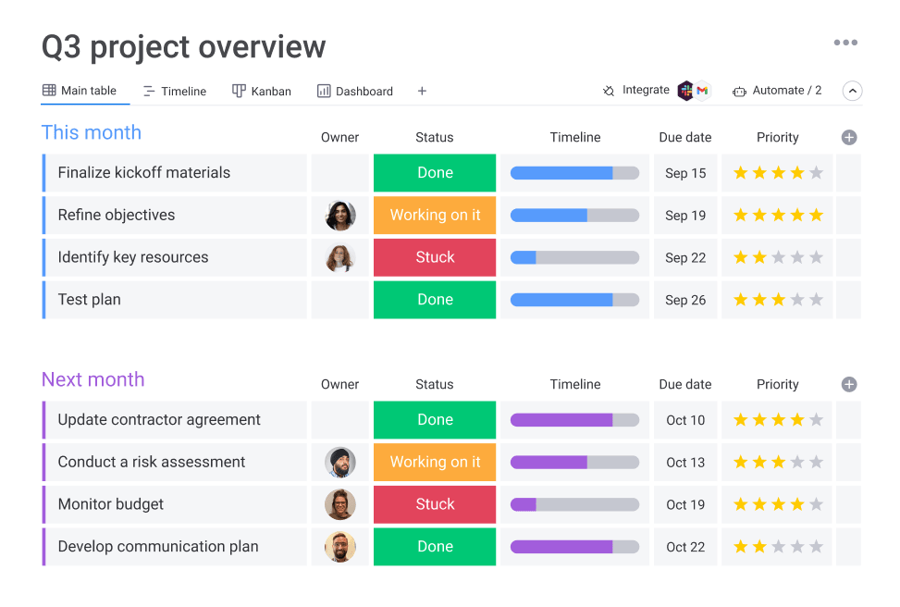
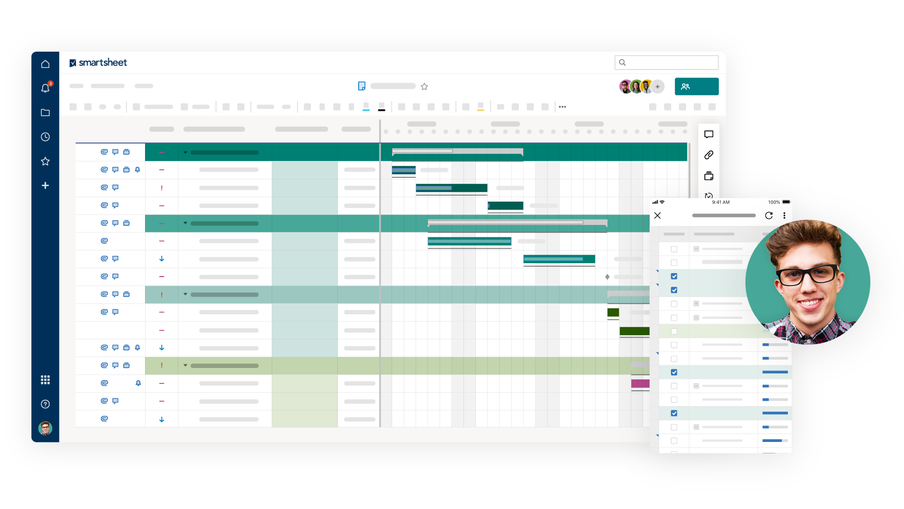
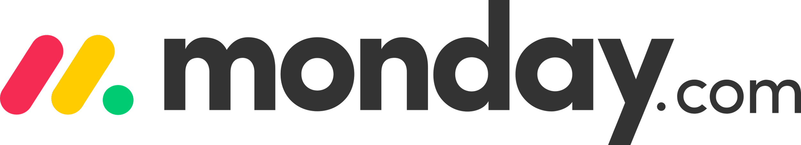
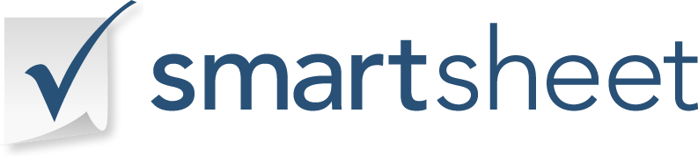
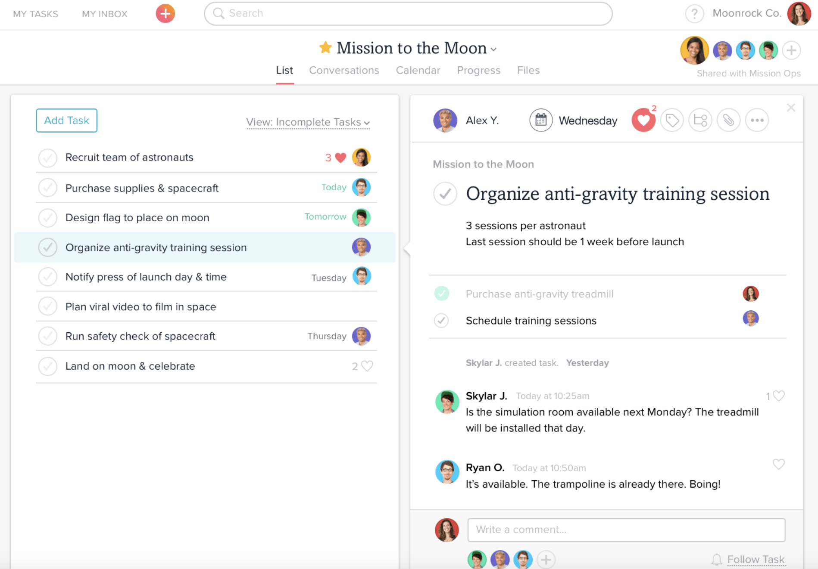
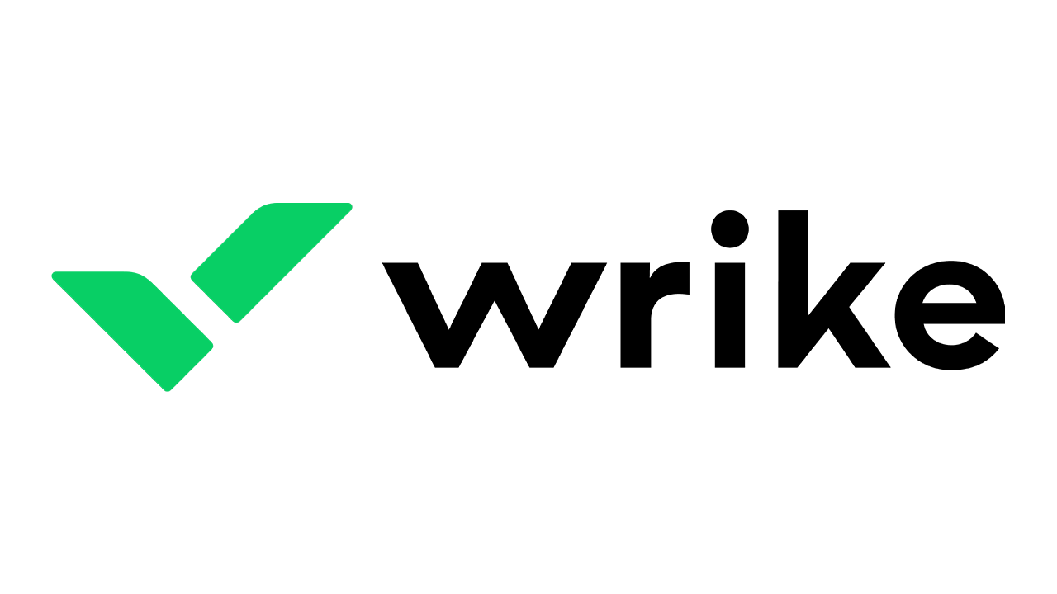
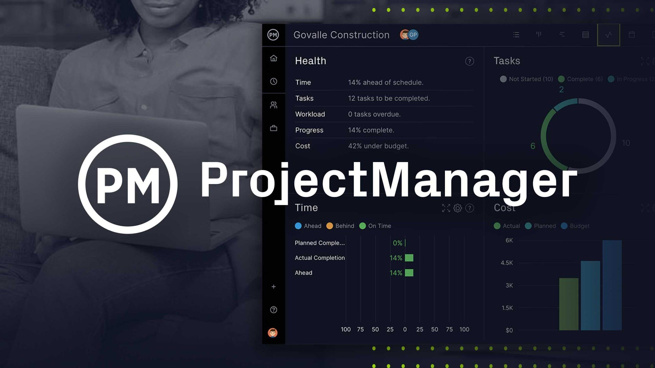

1.5 Utilize Project Management Tools
Notes:
[ANTHONY/INSTRUCTOR 1] [BEGINNING SCRIPT]
Number five, consider using project management software and any kind of integrations that can help you, depending on the software your company uses. Some of these programs include: [CLICK] Monday, [CLICK] Smartsheet, [CLICK] Asana, [CLICK] Wrike, and [CLICK] ProjectManager. These are all different programs that you could use, but your discipline may have specific project management software that works best.​
Regardless of the program, using software or products like these can really help you to be more productive because they can streamline your project management activities and help you to easily share activities and information with other team members. ​At EMI, we use asana [CLICK], and towards the end of the session, I will share some screenshots of how asana works. [CLICK]

Slide 20

1.6 Organize your home base: your desk
Notes:
[ANTHONY/INSTRUCTOR 1] [BEGINNING SCRIPT]
Number six - Now, I’d like to talk about your desk. In addition to affecting your efficiency, the appearance of your desk is a direct reflection of you. A messy, disorganized desk may leave your supervisor, your staff, or your clients, questioning your capability as a professional in addition to adding that stressful mental clutter to your life.​
That being said, in the world of engineering, you often deal with problems all day long, so to think that your desk will always look like the one you see on the screen is not practical.
However, I highly recommend that you set a reminder to clear your desk at the end of each day. I promise, this will have a major positive impact on your morning productivity because you will come into the office with a clear head, a clear desk, and be ready to start your tasks. ​
A former boss of mine had piles and piles of stuff on his desk, and it looked so bad when clients came to the office, it was embarrassing. So, in addition to the mess affecting your productivity, you may also lose clients because of the appearance of your desk.
Lastly, even if you work remotely most of the time, your workspace, including your desk, is usually directly correlated with one’s productivity. So, even if someone can’t see your messy or disorganized desk, it could still be impacting your productivity negatively. [CLICK]

Slide 21
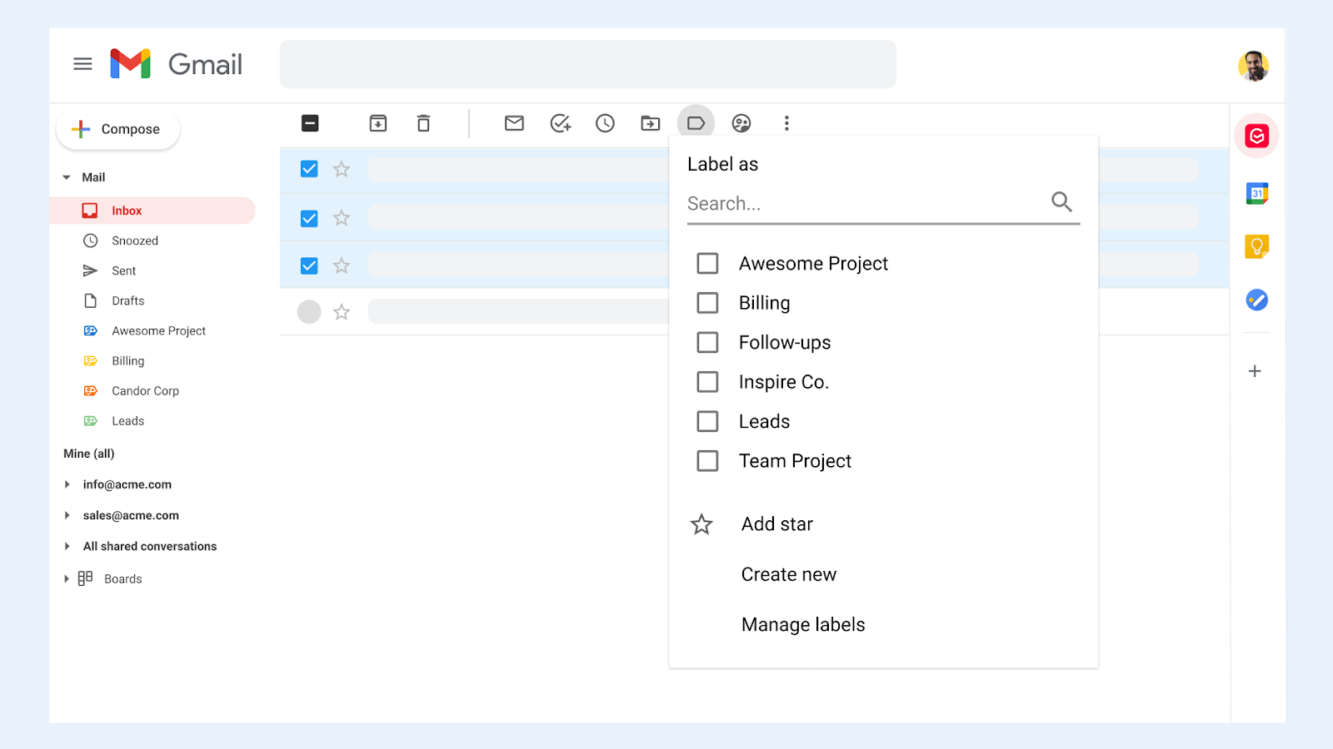
1.7 Optimize your browser using bookmarks
Notes:
[ANTHONY/INSTRUCTOR 1] [BEGINNING SCRIPT]
Number seven - optimize your internet browser using bookmarks. I’m sharing my bookmarks here on the screen, and considering the 80/20 rule, I know I only use 20% of these bookmarks, right? So I don't use them all. ​
​
You should just create bookmarks for the websites that you utilize often, so you never have to type or search or look for them again. They will be right there with the click of a button.​
It’s little things like this that save you a lot of time in the long run. [CLICK]

Slide 22
Summary: Rule #1- Stay Organized
Deploy a minimalist mindset (80/20 Rule)
Organize note-taking
Manage your contacts effectively
Organize your appointments
Utilize project management tools
Organize your home base: your desk
Optimize your browser using bookmarks
Notes:
[INSTRUCTOR 1/ANTHONY] [VIDEO OFF]
That concludes Rule #1 to maximizing productivity, stay organized. Let me recap the 7 items we covered:​
ONE [CLICK] - Deploy a minimalist mindset (remember the 80/20 Rule),​
TWO [CLICK] - Organize your note-taking efforts,​
THREE [CLICK] - Manage your contacts effectively,​
FOUR [CLICK] - Organize your appointments,​
FIVE [CLICK] - Utilize project management tools,​
SIX [CLICK] - Organize your home base, which is your desk,​ AND
SEVEN [CLICK] - Optimize your browser using bookmarks.
Not everyone will need help with ALL of these, focus on the ones that you feel will most positively impact your productivity.​
Before we transition into our next segment, Rule #2, I’d like to pause for a moment here and see if any of our participants here have any questions or comments on these 7 actions you see here on the screen. Maybe you have practiced some of these successfully and can share your experience?
[PAUSE AND TAKE QUESTIONS/COMMENTS - THANK THEM] [CLICK]

Slide 23

Rule #2
Stay Organized
Remain Focused
Reduce Stress
Notes:
[INSTRUCTOR 1/ANTHONY] [VIDEO ON]
Rule #2 in maximizing productivity, is to Remain Focused. Within this rule, I will provide you with seven specific actions that you can take to improve your ability to focus, something that has become very difficult to do in today’s world of unlimited distractions.​ Whether those distractions exist in the workplace, or at home, for those of you working remotely.
​
This is another 20% item that can drive a lot of success, because most people can’t focus, so following some of the strategies we’re about to discuss, will differentiate you.​ [CLICK]

Slide 24

2.1 Create consistency through routines
Notes:
[ANTHONY/INSTRUCTOR 1] [BEGINNING SCRIPT]
Action number one, create consistency through routines. I recommend that you implement some kind of regular daily and or weekly routine that you follow consistently, AND, to take it one step further, build into this routine 90-minute blocks of quiet focus time. This time might be used for mentally demanding tasks like plan review or design or contract review.​
I recommend holding meetings, or site visits, or other “people-related” tasks at the same times each day or week. What a predictable routine will really allow you to do is to stay consistent and establish pockets of quiet time where you can really focus. ​
If you know you have the same open times each week, like Wednesday or Thursday mornings, you can then plan specific tasks during those time periods. This approach will give your calendar some structure, which can be very valuable in terms of productivity and focus.​
But every so often, due to emergencies, your calendar structure will collapse, but that’s okay. When things settle down, you will likely get back to the same structure.​
I want to ask everyone here to share one routine you practice daily or weekly, by typing them in the chat. I will pause for 30 seconds and then quickly read them off.
While you are typing, I will share one of mine. Every Monday morning, I set up my calendar and review my task management system to plan out what tasks I want to delegate and which days I will work on my own tasks throughout the week.
[READ THEM OFF AND THANK THEM]
[CLICK]

Slide 25
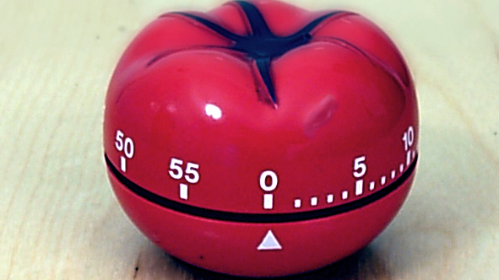
Pomodoro Technique
Notes:
[ANTHONY/INSTRUCTOR 1] [BEGINNING SCRIPT]
One routine that I use during my structured work week is the “Pomodoro technique”, which is a method developed by Francesco Cirillo, an Italian, in the late 1980s.​
This technique uses a timer to break down tasks into intervals. Traditionally, it's 25-minute intervals for work, separated by 2 to 5 minute short breaks. ​
So, for example, if you wanted to use this technique to work on a report for a few hours, you would sit down at your desk, and start the timer. You would work for twenty-five minutes, totally focused until the timer goes off. ​
Then, if you needed a break, you would set a five-minute timer, take a break, and then start the 25-minute timer again. You could repeat this as long as you’d like.​
The timer adds urgency and accountability to your task, so you can stay focused on it. You can use the timer on your phone or buy a simple 1 button desk timer.
I use this technique very frequently as it has proven to really increase my focus.
[CLICK]

Slide 26
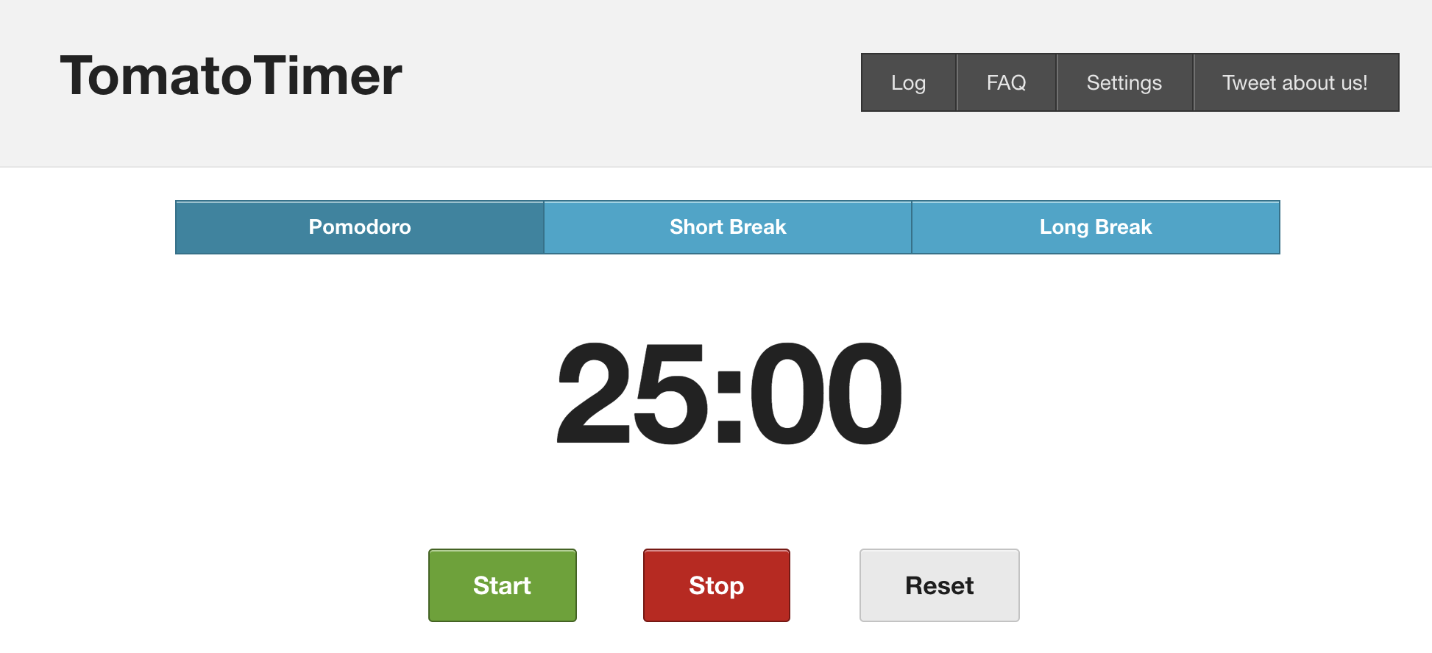
https://tomato-timer.com/
Notes:
[ANTHONY/INSTRUCTOR 1] [BEGINNING SCRIPT]
There are also websites like tomatoDASH timer.com/ which you see here on the screen, that have the timer all set up for you. You just click start and start working. I use this website.
I actually use the Pomodoro technique very frequently as it has proven to really increase my focus.
[CLICK]

Slide 27
Time management gurus agree: Planning ahead is the key to a productive day.
For every 10 minutes you spend on planning, you’ll save how much time in execution?
20 minutes
30 minutes
45 minutes
1 hour
Notes:
[ANTHONY/INSTRUCTOR 1] [BEGINNING SCRIPT]
quick poll for you all. [read off poll question and give time to answer]
Answer: D. Toggl CEO Alari Aho is a stickler for a well-thought-out approach to the day. "Every 10 minutes you spend on planning saves you an hour in execution," he says in an interview with Fast Company. What other investment pays off so well—and so quickly?
Start paying attention to how you spend your 168 hours each week, and you might be surprised at just how much time you really have. As time management expert Laura Vandercamp says, "Time is highly elastic. Put first things first, and it's amazing how efficient you can become."
https://www.allbusinessschools.com/business-administration/common-questions/make-time-for-school-quiz/

Slide 28

2.2 Establish your daily MITs
Notes:
[ANTHONY/INSTRUCTOR 1] [BEGINNING SCRIPT]
Action number two for remaining focused is to establish your daily MITs. MITs, which stands for most important tasks, should be the tasks that will deliver the biggest results or have the highest impact for you and your company. ​
I learned about MITs from a book titled “The Power of Less: The Fine Art of Limiting Yourself to the Essential...in Business and in Life” by Leo Babauta. At the end of this session, I will share a list of all of the books I’ve mentioned.​
Identifying these MITs on a daily basis is critical to staying focused and being productive. In identifying your MITs, consider the 80-20 rule.
Focus your MITs on the 20% of tasks that really matter and build your MITs into your daily routine, preferably early in the day. This will result in major success, as long as you select the right MITs. ​Later I will provide a tool for selecting the right MITs.
One example of this in my own life is when I decided to write my book “Engineer Your Own Success”. I wrote for one hour very early every morning. Doing so ensured that I was making progress every day, which was a clear MIT. I took the same approach when I studied for my professional engineering licensure exam. I studied every morning because that was my priority task and I wanted to ensure I made progress every single day.​
Now we are going to review a few tools that can help identify your MITs. From a big picture perspective, when you think of your most important tasks, think about them based on the image you see on the screen here. If you get your MITs completed early in the morning, the remainder of your day will be less stressful because you know you’ve already completed the Most Important Task of the day.
While many professionals like this MIT approach to their day, we often get the question, how do I identify my MITs? Let’s look at a few approaches and tools you can use. [CLICK]

Slide 29
Eisenhower Box
URGENT
NOT URGENT
IMPORTANT
DO
DECIDE
MITs
NOT IMPORTANT
DELEGATE
DELETE
Should you do it?
Notes:
[ANTHONY/INSTRUCTOR 1] [BEGINNING SCRIPT]
To prioritize MITs, some people like to use the “Eisenhower matrix”, which is sometimes referred to as the urgent-important matrix to help decide on and prioritize MITs and other tasks. ​
It's named after Dwight D Eisenhower, the thirty-fourth president of the United States, because he had to make tough decisions about which of his many tasks he should focus on each day. To help him, he invented the now famous Eisenhower Matrix, which helps prioritize items by urgency and importance. ​
You can see the quadrants here, urgent and not urgent on one access, important and not important on the other axis. So, any item that's [CLICK] urgent and important, gets priority, helping to identify MITs.​
If an item is not urgent but is important [CLICK], you must decide when to tackle that task, and it may or may not be an MIT for that day. If it's urgent but not important [CLICK], delegate it, if at all possible. And if it's not urgent and not important [CLICK], then why are you even considering doing it? ​
You might find this matrix helpful when prioritizing your weekly or daily tasks, especially when you have many competing tasks.​
This matrix may work for you, however, I’d like to show you another tool that I use when deciding on my MITs. [CLICK]​

Slide 30
80/20 Chart
Effort vs Impact
LOW IMPACT
HIGH IMPACT
HIGH EFFORT
HIGH EFFORT
LOW IMPACT
HIGH EFFORT
HIGH IMPACT
MITs
LOW EFFORT
LOW EFFORT
LOW IMPACT
LOW EFFORT
HIGH IMPACT
MITs
Notes:
[ANTHONY/INSTRUCTOR 1] [BEGINNING SCRIPT]
Another matrix, which I refer to as the 80/20 Chart, which is from Richard Koch’s book “Living the Eighty Twenty Way”, may be more appealing to you.​ This is on page 21 in your workbook.
The axes are low effort and high effort, and low impact and high impact. So, you are focusing on the relationship between [CLICK] effort and impact, which I highlighted earlier in this session as the absolute key to maximizing productivity. ​
Basically, the tasks that are high impact and low effort, which would fall into the red box, would be your MITs [CLICK] or the best tasks to focus on. You can complete these tasks in a short amount of time, like maybe calling a client once a week to check in and they can yield high impact results long-term. ​
Now, high effort, high impact tasks, like writing a large proposal for a new project, may also be considered an MITs [CLICK]. They may take you a lot of time to complete, but if successful, they will yield a very positive impact for your company. You might just split these MITs up into mini-MITs. For example, write an outline for the proposal, write section one, and so on.​
​
And then, you have other types of tasks like high effort, low impact or low effort, low impact. For example, paying your bills. It doesn't take a lot of effort or drive a lot of impact, but you have to do it. You can't avoid it. ​
So, you can use this tool to prioritize your tasks and focus on MITs.​
Once a week, I categorize my tasks into this matrix, and I focus on the ones that are high impact early in the day and early in the week. ​
Whereas the ones that are lower impact, I tend to tackle them in the afternoons when I'm kind of tired or burnt out or towards the end of the week. ​
This approach has been extremely helpful for me. At EMI, we’ve published a video on our YouTube channel where I've put this matrix on a whiteboard and explain how I go through this process each week, which you can follow along with if you’d like to try it. The video is named “How to use the 80/20 Chart to Supercharge Your To-Do List” and we will include a link in the email that you receive after this session.
Don’t underestimate this method, it may be the best way to stay focused on what really matters.​ This is included in your workbook on page 21. [CLICK]

Slide 31

2.3 Prioritize MIT Completion
Delegate when possible…
Notes:
[ANTHONY/INSTRUCTOR 1] [BEGINNING SCRIPT]
​Next, once you establish MITs, you may find that you have quite a few of them. But just because you have identified them as your MITs doesn’t mean that they can’t be delegated. That’s the key point here.​
You can either attack your MITs yourself or delegate them [CLICK] and remember to do this first thing in the morning, because if you don't you won't complete your MITs and you won’t generate results for yourself or your company. ​
And on top of that, you'll likely be stressed because you’re not accomplishing your most important tasks.
We cover delegation in detail in our Level II course, but I just wanted to mention here to emphasize that you do not have to attack all your MITs yourself. [CLICK]

Slide 32

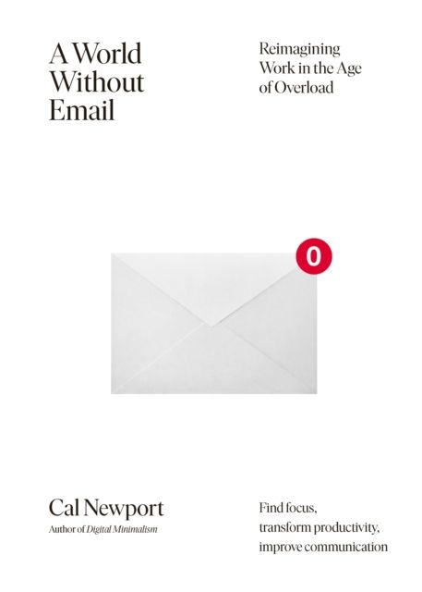
2.4 Don’t let email dictate your schedule
Notes:
[ANTHONY/INSTRUCTOR 1] [BEGINNING SCRIPT]
Action number four is a focus killer: EMAIL. ​
There's a great quote about email by author Brendan Burchard: “Email is someone else's way of managing your day.” This is so true, because if you check emails constantly and respond to every email immediately, you're letting people who are emailing you, run your day. They’re deciding what you are working on at every moment.​
So, Are you going to allow someone else to dictate your day? I hope not. ​
Here are a couple of things you can do to make sure this doesn't happen to you. ​
First, turn off all email notifications. This is extremely important. When you're trying to focus on MITs, if email notifications keep popping up, it’ll be very distracting.
Avoid checking emails constantly. Attempt to create blocks of email time, so you can maintain blocks of focused work.
For example, maybe you check your email twice in the morning and once later in the afternoon. Instead of email having open access to you all day, check in when convenient for you. That being said, I realize that some of you work on time sensitive projects that can have urgent issues, but even then, you shouldn’t have to be “ON'' 24-7, you should still be able to check email periodically, maybe you just do it more often than others.
If this is a big issue for you, I highly recommend you check out the book titled, “A World Without Email” by Cal Newport [CLICK] which captures the dangers of email and other unstructured communication channels like Slack and how you can manage in a way that minimizes distractions. [CLICK]

Slide 33
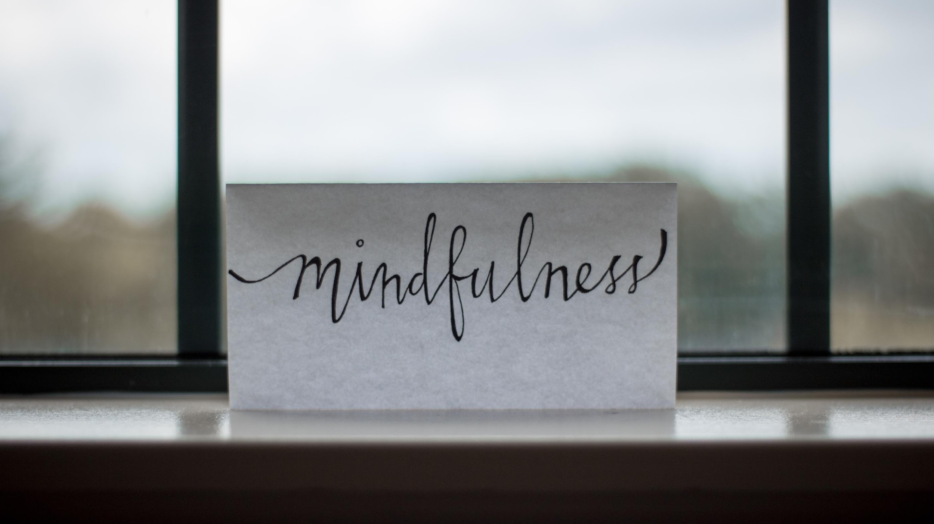
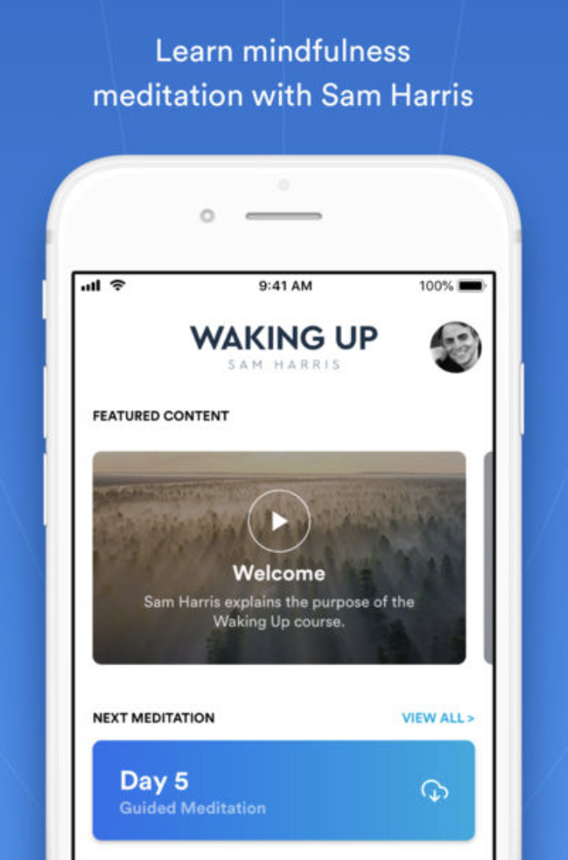
2.5 Meditate
Notes:
[ANTHONY/INSTRUCTOR 1] [BEGINNING SCRIPT]
Number five is meditation. Meditation has been proven to increase focus, reduce stress and facilitate better sleep patterns. ​
Meditation can be two minutes of deep breathing to help you clear your mind before a task, or it could even be a simple ten-minute walk to clear your head.​
Taking actions like these can drastically improve your focus. ​
I do ten minutes of meditation each morning before I start work, just to clear my mind, and it really has helped me tremendously. It's almost like exercising your brain and teaching your brain to quiet itself. And when you're talking about the ability to focus, your brain needs to be able to do that and you need to train it to. ​
If you think meditation is a stretch for you, and not possible, I thought the same, and then an engineer who I interviewed for our podcast turned me onto the [CLICK] Waking Up app by Sam Harris, a neuroscientist who discovered the benefits of meditation and built this popular app that provides simple daily guided meditations. Using his app, I have logged over 6,000 minutes of mediation in the past few years, and believe me when I say I was terrible when I started. So if you want to give it a shot, check out the app.
So, quiet time, meditation, breathing. These actions can help you slow things down and become more focused and ultimately more productive. ​[CLICK]

Slide 34

X
2.6 Put yourself in a position to FOCUS
Notes:
[ANTHONY/INSTRUCTOR 1] [BEGINNING SCRIPT]
Number six, in regard to focus, you MUST put yourself in a position to focus. ​
I've been giving you different strategies for how to focus, but the most important one is that you put yourself, in an atmosphere, where you can focus. ​
For example, if you have to do a focused review of project plans, don't sit at your desk with your door open. Go to a conference room and shut the door. ​
If you don't put yourself in a conducive atmosphere for focusing, you'll probably get distracted and lose your focus. ​
This is so important, yet time and time again, I see engineering professionals working in these open office areas where people are constantly interrupting and distracting them and adding stress to their work. ​Now, COVID, of course, has changed this, and likely has forced people to work more in closed areas, away from others, which ultimately may be helpful for focusing.
Ultimately though, you have to avoid distractions by putting yourself in an atmosphere to focus. Find a quiet area where you can work on tasks that require heavy focus.​ And it’s not only a quiet area, you need to turn off or [CLICK] put away your cell phone or other distractions. [CLICK]

Slide 35
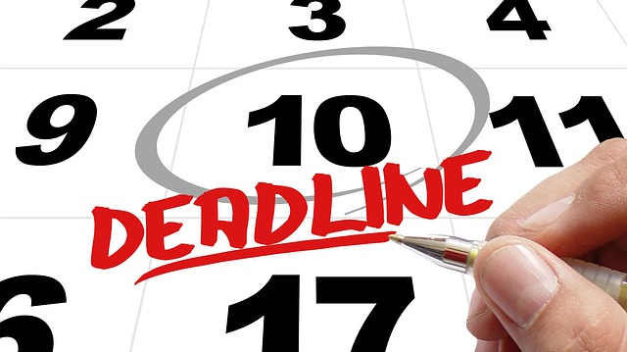
2.7 Create urgency through deadlines
Notes:
[ANTHONY/INSTRUCTOR 1] [BEGINNING SCRIPT]
Lastly, number seven with regard to focus: Create urgency through deadlines. ​
As an engineering professional, it's highly likely that deadlines already exist for you, but by creating them where they are not present, you will force yourself to focus even more. ​
Otherwise, without deadlines, you might fill your day with tasks that are only generating the 20% of your results.​
I've seen this in my life in so many different ways. As an engineer, when it came to projects, when we had a deadline, we met it. When I was studying for my PE licensure exam, I had already registered for the exam that was being held on a certain date, so I had a deadline. ​
Even personally, I remember for a long time there was a crack in my living room ceiling that needed to be spackled and painted. I kept putting it off for months and months, maybe even a year. Finally, we invited some friends over for dinner, and sure enough I did the work. I could have done it a year ago, but I didn't have a deadline, and I didn't have a reason to get it done.​
You probably hear all the time that you have to motivate yourself with some kind of deadline. Sometimes that means creating the deadline yourself, by signing up for something. If you want to become a better public speaker, sign up for Toastmasters and commit to giving your first speech and I guarantee you're going to make progress. ​
Deadlines drive focus!​ [CLICK]

Slide 36
Summary: Rule # 2- Remain Focused
Create consistency through routines
Establish your daily MITs
Prioritize MIT completion
Don’t let email dictate your schedule
Meditate
Put yourself in a position to focus
Create urgency through deadlines
Notes:
[ANTHONY/INSTRUCTOR 1] [BEGINNING SCRIPT]
That concludes Rule #2 for maximizing your productivity, “Remaining Focused”. Let me recap the seven items we covered: [CLICK]:
1 - Create consistency through routines,​ [CLICK]
2 - Establish your daily MITs,​ [CLICK]
3 - Prioritize MIT completion,​ [CLICK]
4 - Don’t let email dictate your schedule,​ [CLICK]
5 – Meditate,​ [CLICK]
6 - Put yourself in a position to focus, ​AND LAST BUT NOT LEAST [CLICK]
7 - Create urgency through deadlines.​
Again, I realize this is a lot of information, but not everyone will need help with ALL of these, so focus on the ones that you feel will most positively impact your productivity. I would bet that email is one that would help everybody.​
​
Okay onto rule #3…[CLICK TO NEXT SLIDE]​

Slide 37
Rule #3
Stay Organized
Remain Focused
Reduce Stress
Notes:
[INSTRUCTOR 1/ANTHONY] [VIDEO ON]
Rule #2 in maximizing productivity, is to Remain Focused. Within this rule, I will provide you with seven specific actions that you can take to improve your ability to focus, something that has become very difficult to do in today’s world of unlimited distractions.​ Whether those distractions exist in the workplace, or at home, for those of you working remotely.
​
This is another 20% item that can drive a lot of success, because most people can’t focus, so following some of the strategies we’re about to discuss, will differentiate you.​ [CLICK]

Slide 38

“Worrying is like a rocking chair. It gives you something to do, but gets you nowhere.”
- Glen Turner
Notes:
[ANTHONY/INSTRUCTOR 1] [BEGINNING SCRIPT]
I’d like to start the section on stress reduction with a quote from Glenn Turner: “Worrying is like a rocking chair, it gives you something to do but gets you nowhere.” ​
I start with this quote because, often, a big part of stress stems from worrying, but the act of worrying doesn't help you at all.​
So next time you are worrying about whether or not you will make a deadline, don’t worry, just execute. This shift alone will reduce stress.​
In rule number three here, I will provide you with seven strategies for reducing stress, which will help you be more productive.​ [CLICK]

Slide 39

3.1 Simplification through elimination
Notes:
[ANTHONY/INSTRUCTOR 1] [BEGINNING SCRIPT]
Number one, simplification through elimination. We have so many devices today, and I want to urge you to streamline your device usage. ​
So, if you have a tablet or iPad, use it for specific things, the same with your phone or your computer.​
For example, I use my iPad strictly to read books on Kindle. I process all of my emails on my computer and mostly use my phone for text messages and phone calls. ​
People get the same notifications on all of these devices.
This is so redundant and overwhelming.
These multiple notifications are creating stress and you'll never feel productive because you’ll always feel like you're trying to dig yourself out of a hole in terms of productivity. ​[CLICK]

Slide 40
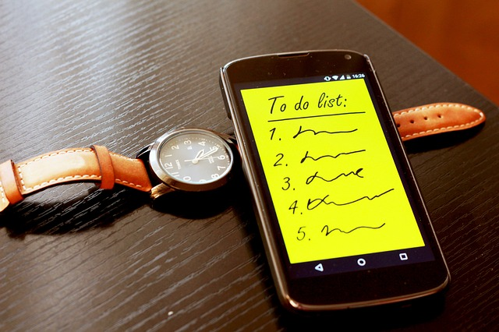
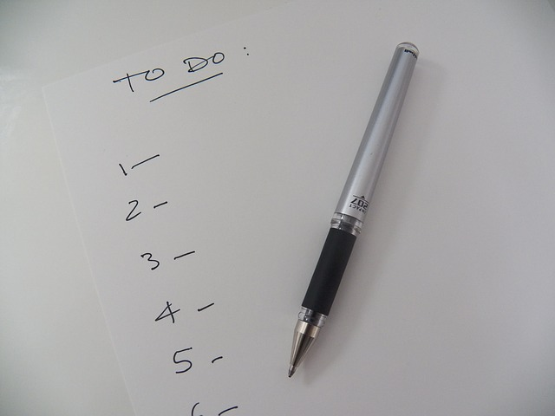
3.2 Create a functional to-do list
Online
Offline
Notes:
[ANTHONY/INSTRUCTOR 1] [BEGINNING SCRIPT]
Number two, create a functional to-do list. Creating a functional to-do list can be very beneficial in terms of stress reduction, I recommend a blend of online and offline approaches depending on what works best for you. ​
At EMI, we use a great online tool called Asana,. Asana really helps me manage my to-do list and share tasks easily with other team members. It makes it very easy to view an assigned task and it allows me to easily identify my MITs each day. ​
This greatly reduces stress, because I know exactly what needs to get done. I know what my most important tasks are and I can focus on them. ​
Now, I know, fires will arise and you'll have to put them out throughout the course of the day and you can certainly use some of what we’ve discussed previously to do that, but regardless, you should have a plan and a good to do list that can help you stay focused.​
In addition to the software we use, I also sometimes like to write down some of my MITs for the day on a piece of paper.​
Figure out what works best for you, but the team task sharing ability may really help streamline your efforts.​
Before I go on to our next point, I’d like to show you a few screenshots from the system we use, asana. [CLICK]

Slide 41
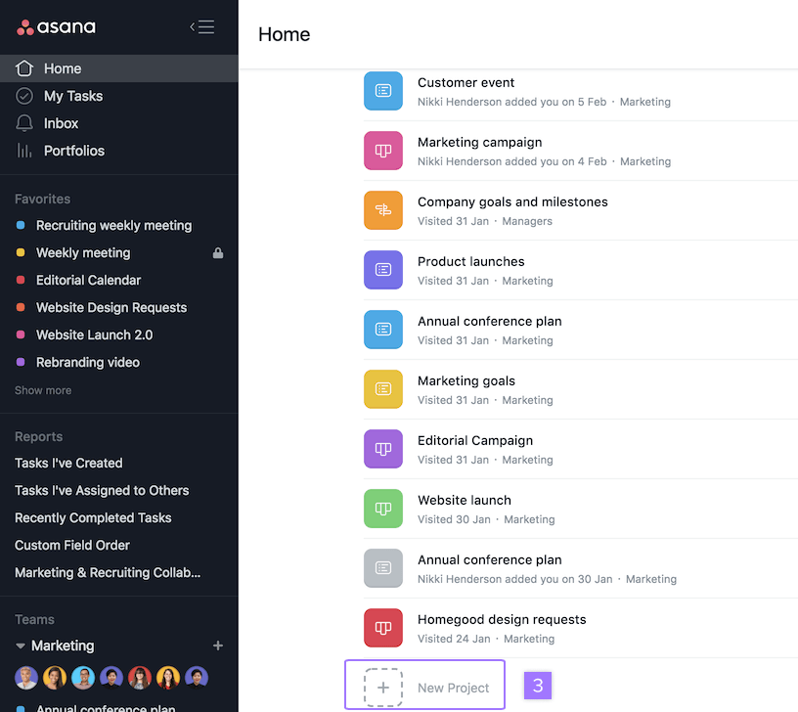
Notes:
[ANTHONY/INSTRUCTOR 1] [BEGINNING SCRIPT]
So, this is asana. Firstly, I want to show you the Project view. You can see here, [CLICK] it allows you to create different projects.
You can also see these projects in the sidebar [CLICK].
These could be your different engineering projects. They could also be personal projects, like PE exam preparation, or organize Professional Association meeting.
Then if you click on a project. [CLICK]

Slide 42
Notes:
[ANTHONY/INSTRUCTOR 1] [BEGINNING SCRIPT]
You can see all of the tasks associated with that project. In asana, you can create tasks with deadlines that can be attached to a project. You can also assign them to individuals on your team and put a deadline on them.
Here is a task [CLICK]
Here is the deadline [CLICK]
Here is the person it is assigned to [CLICK]
Now, in my opinion, the best part of this program is the calendar view…[CLICK]

Slide 43
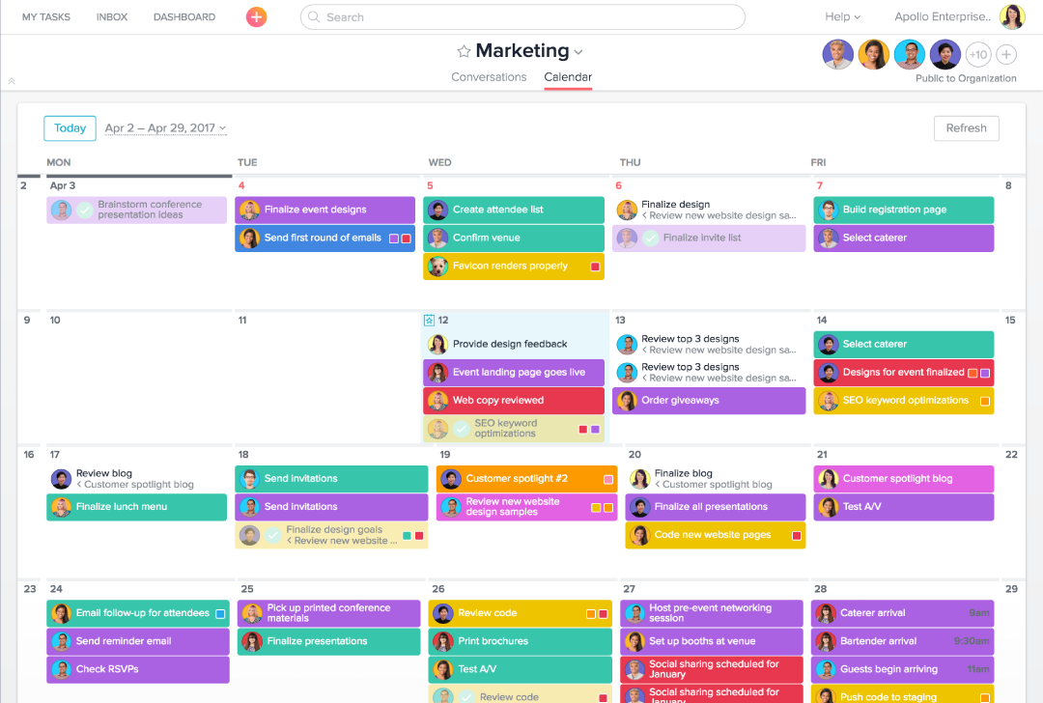
Notes:
[ANTHONY/INSTRUCTOR 1] [BEGINNING SCRIPT]
This is my favorite part of asana and I use this view daily. This allows you to view your tasks (and your team's tasks) by day.
This provides a great weekly planning tool.
It can help you see if someone has more tasks then they should or if someone is light on tasks. You can view everyone’s tasks on the calendar at the same time, or click on one person and view their tasks only.
When I have my weekly meetings with my direct reports (one-on-one) meetings, we do a share screen and we have their calendar view on the screen.
Why am I talking about this in the Reduce Stress section? Because I have found that when you have all of your tasks in one place and you can see them, even if you have a lot to do, you feel less-stressed. At least I do.
So there’s a look at asana. There are other programs like this out there, but whichever you use, be sure to build a functional to-do list.
Why don’t we pause here and please go ahead and type in the name of the task management system that you use and I will read them off. If you don’t use one, type “none” - just so we can see how many of you are using one. [PAUSE FOR 30 SECONDS AND READ THEM]
[CLICK]

Slide 44
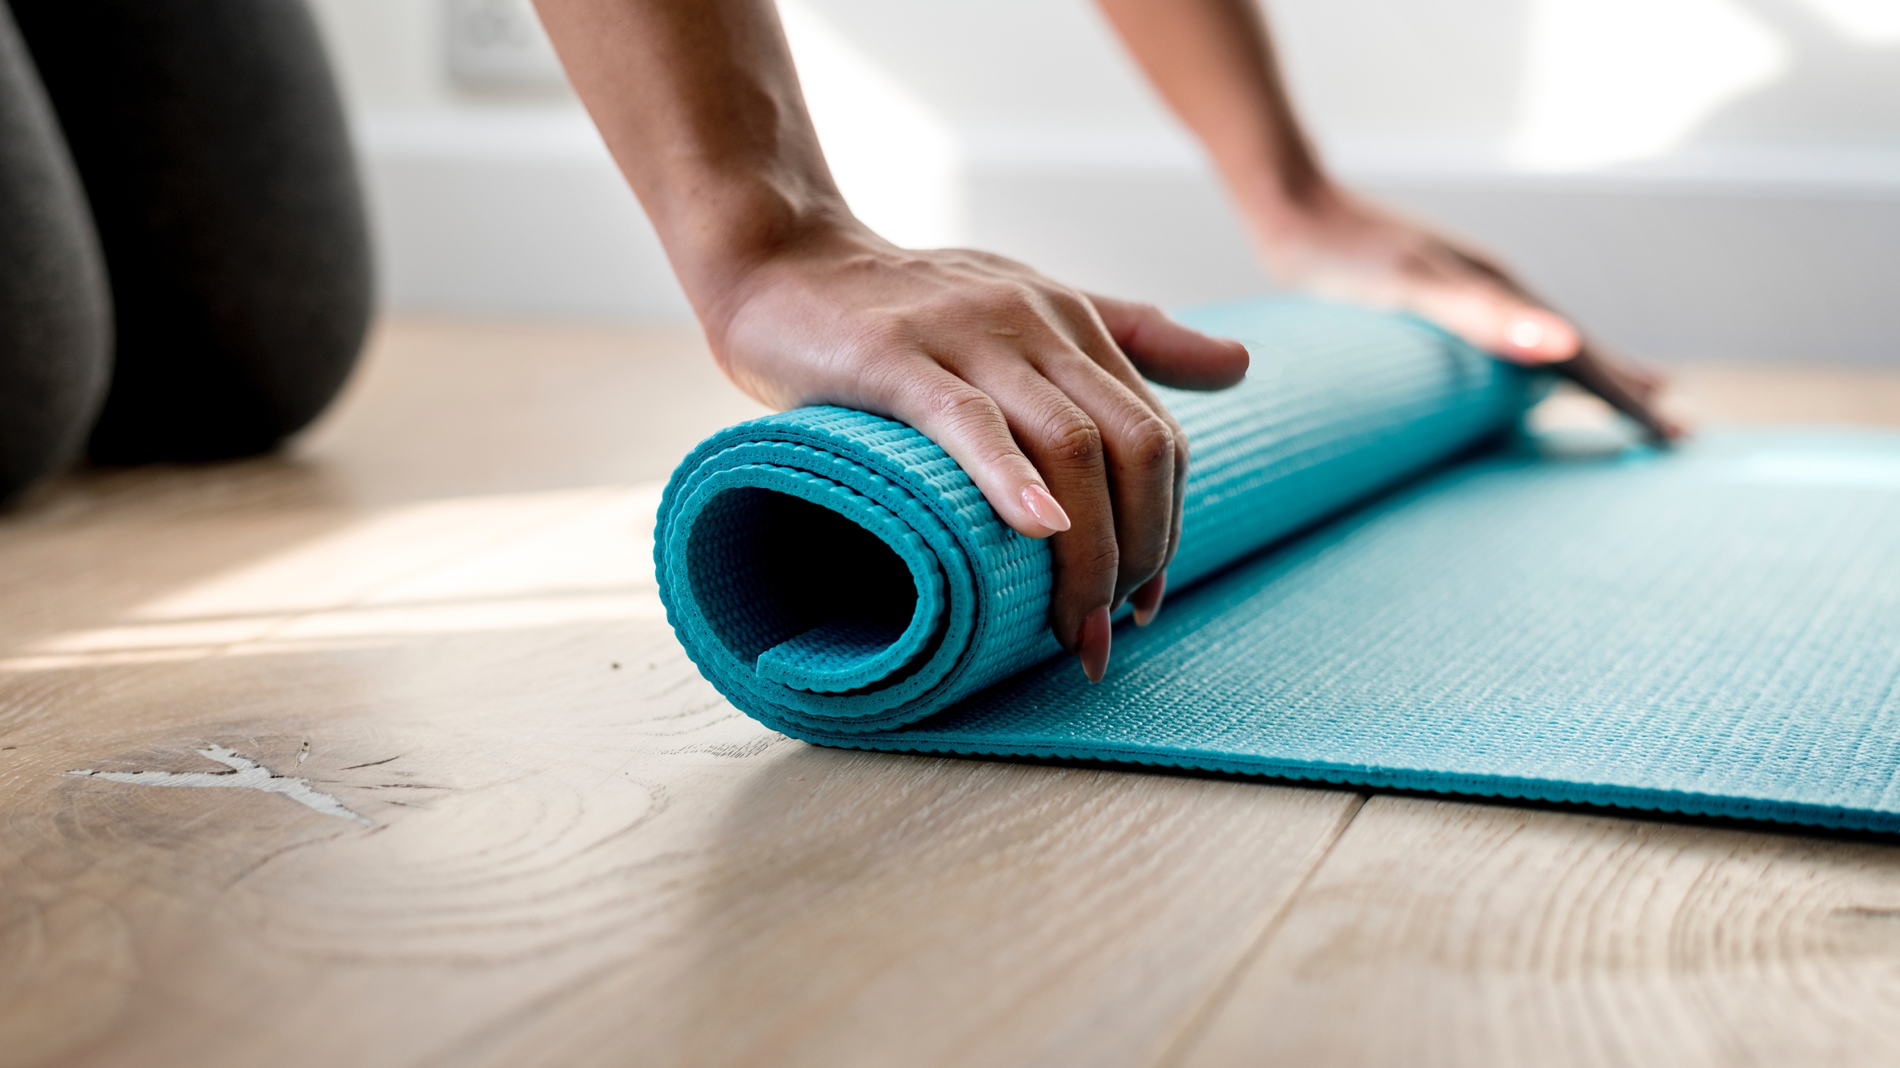
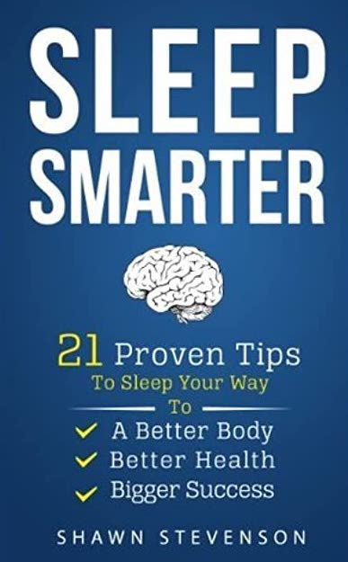
3.3 Keep your mind and body in shape
Meditate
Read (Fiction)
Exercise
Notes:
[ANTHONY/INSTRUCTOR 1] [BEGINNING SCRIPT]
Number three is to keep your mind and body in shape. ​
Being physically fit can also help you to reduce stress and here's three tips to help you keep your mind and body in shape. ​
Number one, as I mentioned before, [CLICK] meditation can be very helpful. ​
Number two, [CLICK] reading, and specifically reading fiction in the evenings to help your brain wind down. ​
I started doing this a few years ago and it's been a complete game changer for me. In fact, I read a book called “Sleep Smarter” [CLICK] by author Shawn Stevenson that listed 21 strategies for sleeping better and one of them was reading fiction at night, because when you read fiction, you don't have to think about anything and it puts your mind at ease. This helps to quiet your mind after a busy day.​
And the last one is [CLICK] physical exercise, which could be as easy as a walk each day at lunch or in the evening. ​
I take a twenty minute walk every day at lunch and if I feel a little bit stressed because I have a lot of work to do, I'll just make some phone calls during my walk to feel productive. ​
Keep your mind and body in shape. ​[CLICK]

Slide 45

3.4 Eat and sleep well
Notes:
[ANTHONY/INSTRUCTOR 1] [BEGINNING SCRIPT]
Number four - Eat and sleep well. ​
Firstly, just a disclaimer. I'm not a doctor, however, it is somewhat obvious that your diet and the quality of sleep greatly impacts your energy levels and career success. ​
So, consider a high protein, low carbohydrate, or low sugar diet. However, please consult a doctor or nutritionist to design the best possible diet for you. ​
Again, I do want to recommend Shawn Stevenson's book “Sleep Smarter” 21 Proven Tips to Sleep Your Way to a Better Body, Better Health, and Bigger Success. ​
Since I've read that book, I have greatly improved my sleeping habits, which has helped with my productivity overall. ​[CLICK]

Slide 46

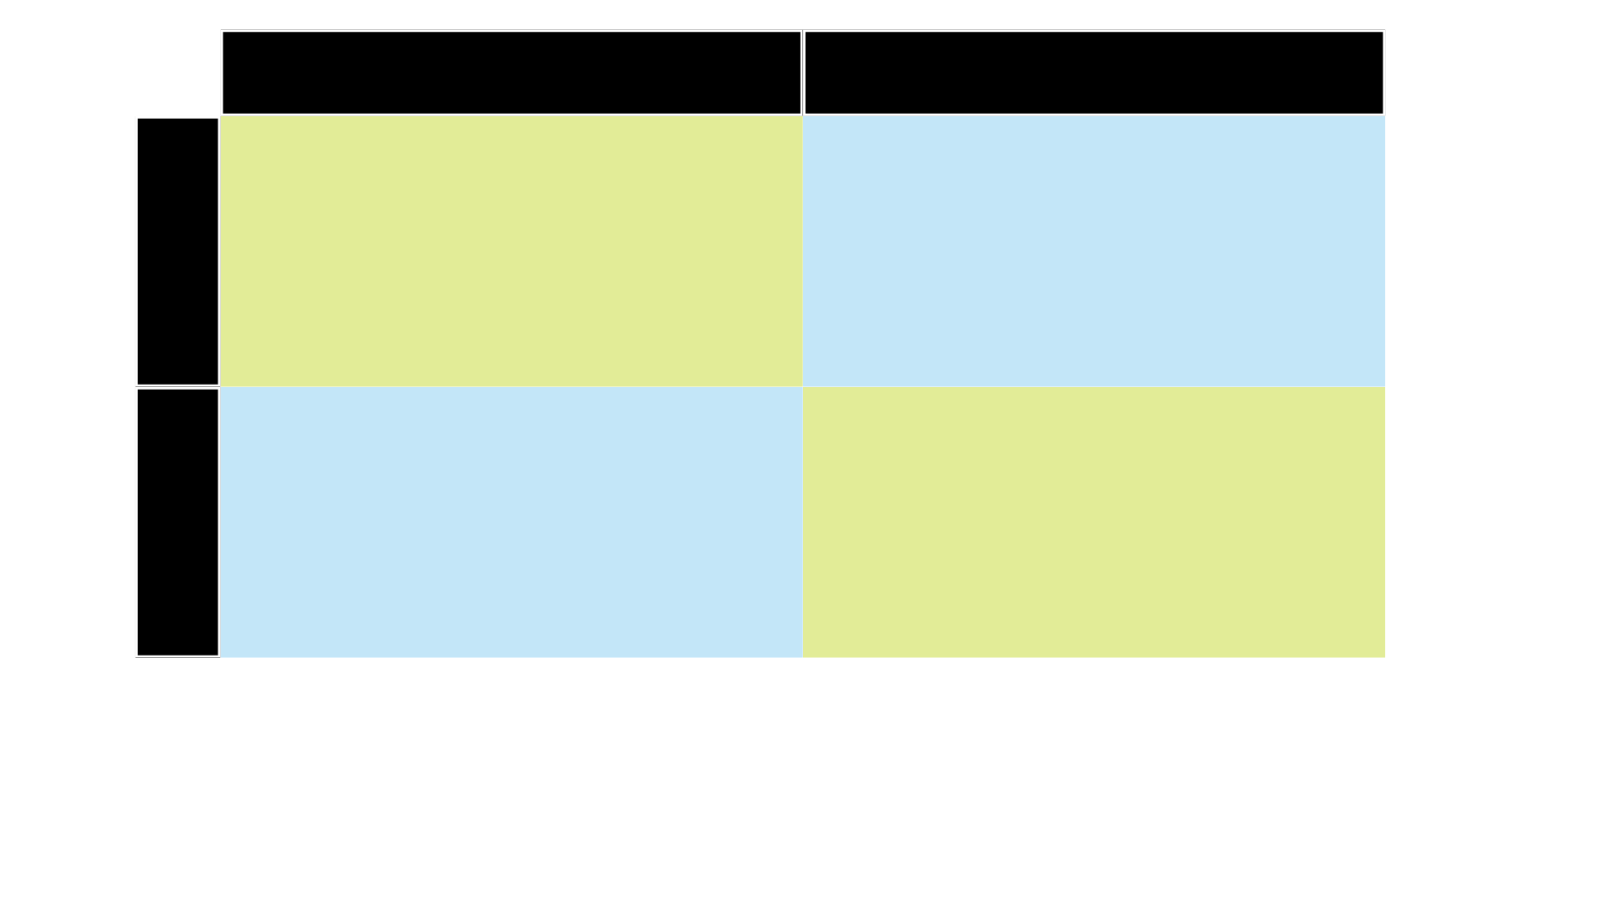
3.5 Make the most of waiting/idle times
LOW IMPACT HIGH IMPACT
LOW IMPACT HIGH IMPACT
HIGH EFFORT
HIGH EFFORT HIGH EFFORT
LOW IMPACT HIGH IMPACT
LOW EFFORT
LOW EFFORT LOW EFFORT
Notes:
[ANTHONY/INSTRUCTOR 1] [BEGINNING SCRIPT]
Number five is to make the most out of idle time. ​
For example, when I travel on airplanes, I know that for the first thirty minutes while the plane is ascending, I can't have any electronic devices on, so I'll typically bring a book or report that I have to read or a notebook and a pen to sketch something, taking full advantage of the 30 minutes.​
An engineering manager who learned about this strategy in one of our training sessions, started listening to audiobooks on his commute which really impacted his management style and success.​
So, think about ways that you can make the most out of your time. Maybe even go back to the 80/20 chart [CLICK] that I provided you earlier. . You might be able to take care of the low effort, low impact tasks during idle time.​ [CLICK]

Slide 47

3.6 Schedule your relaxation time
Notes:
[ANTHONY/INSTRUCTOR 1] [BEGINNING SCRIPT]
Number six - Schedule your relaxation time.​
We have everything on our calendars, from project meetings to phone calls, but we never mark our calendars to make sure that we take time for ourselves. ​
Why not?!
I now schedule my lunch walks on the calendar, and that helps me stick to them and signifies that they are just as important as everything else on my calendar.​ Try scheduling your down time and make it a priority. [CLICK]

Slide 48
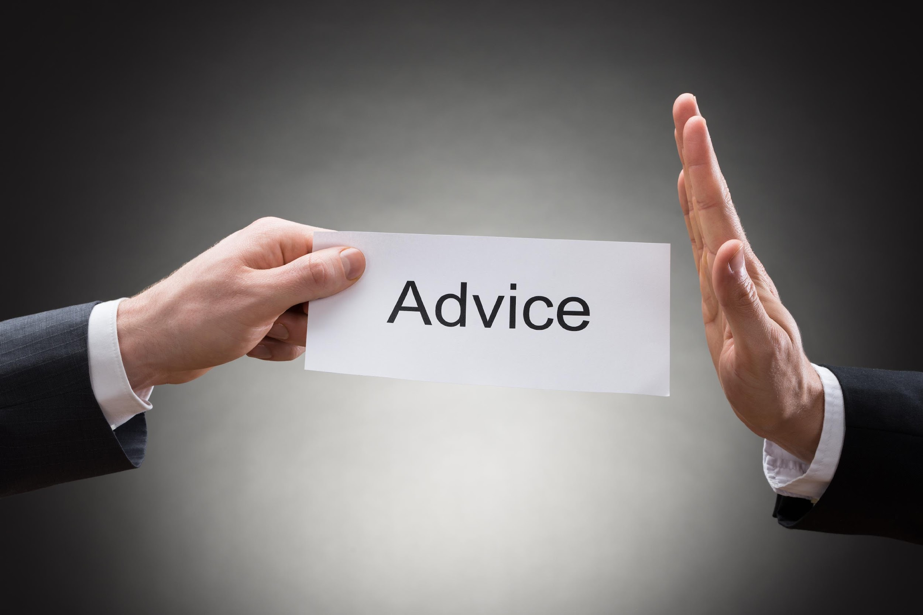
3.7 Learn to say “No”
Offer
Notes:
[ANTHONY/INSTRUCTOR 1] [BEGINNING SCRIPT]
Number seven - Here's one that's very difficult for most of us to do. Learn to say NO.​
Your time is precious, don't waste it on people or projects that don't align with your or your company’s mission or goals. ​
Instead of constantly accepting invitations and offers with little thought, consider saying something like, “Let me check my schedule and get back to you,” giving yourself some time to evaluate these offers legitimately and make smarter decisions. ​
Whenever we answer a question or request too quickly, in the moment, the tendency is to respond, “sure,” OR, “yes,” but it's not always the best response.​ [CLICK]

Slide 49
Summary: Rule # 3- Reduce Stress
Simplifications through elimination
Create a functional to-do list
Keep your mind and body in shape
Eat and sleep well
Make the most of waiting/idle times
Schedule your relaxation time
Learn to say no
Notes:
[INSTRUCTOR 1/ANTHONY] [VIDEO ON]
That concludes Rule #3: to Maximizing your Productivity, “Reduce Stress”. Let me recap the seven items we covered:​ [CLICK]
Number One - Simplification through elimination, streamline your device usage,​ [CLICK]
Number Two - Create a functional to-do list,​ [CLICK]
Number Three - Keep your mind and body in shape,​ [CLICK]
Number Four - Eat and sleep well,​ [CLICK]
Number Five – Make the most of waiting or idle time,​ [CLICK]
Number Six - Schedule your relaxation time just like you schedule everything else, AND​ [CLICK]
Number Seven - Learn to say no.​
Next, before I recap the three rules, I want to touch on the subject of work-life balance. [CLICK FOR NEXT SLIDE]​

Slide 50
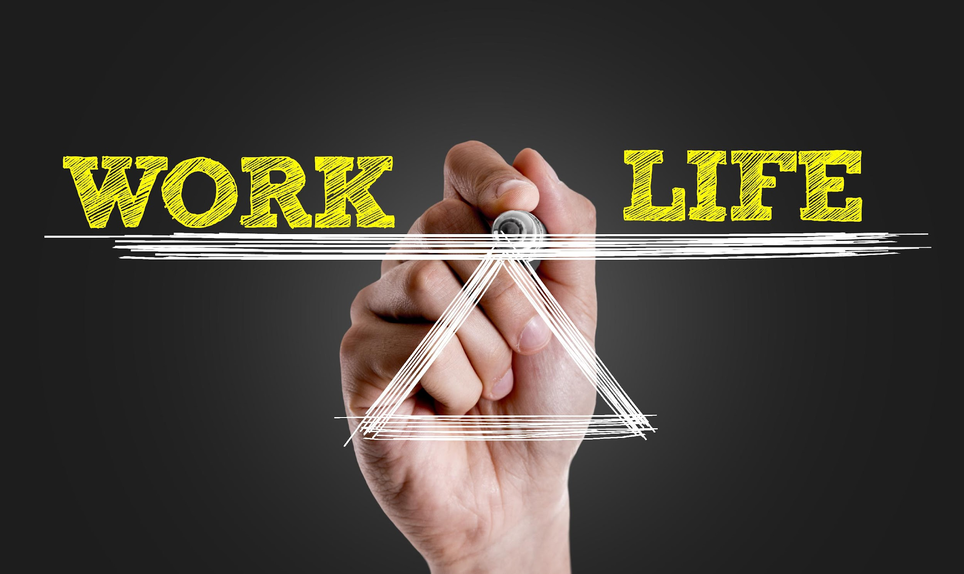
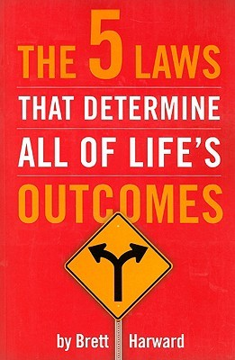
Is balance possible?
Notes:
[ANTHONY/INSTRUCTOR 1] [BEGINNING SCRIPT]
A question I get from engineering professionals very often is, “Can I be a successful engineering professional and also maintain work-life balance?”​
I believe that work-life balance is possible, but to achieve it, you must do three things. ​
First, define balance. What does balance mean to you? Everyone defines it differently. I worked with an engineer once who defined balance as the ability to be home with his family for dinner, three or four nights each week. Achieving that, created balance for himself. So, first, define what balance means to you. ​
Number two, build flexibility into your career. Maybe your company allows you to work from home once in a while, or maybe they offer flex hours, allowing you to start work early and leave early some days. ​Obviously with COVID-19 everyone was home, but that is starting to change again.
And the third one, and my favorite one, is to be present. Let me explain this one with a story. Brett Harward is the author of an excellent l book entitled, [CLICK] “The Five Laws That Determine All of Life's Outcomes”
During a live presentation that I attended, he talked about Work-Life Balance. ​
He said, “If you think about your life as a two-dimensional pie chart, very rarely will the pie be cut in half in terms of the amount of time you spend at work and the amount of time you spend at home. It's never going to happen that it's the same number of hours every week for each. But, what’s most important is the depth of the slices of the pie, thinking in three dimensions”. ​
So, when you're at work, be into work, be fully focused on work t and give it your all, BUT, when you're at home, forget about work. Be focused at home, be focused with the people at home and put all of your effort and energy into those interactions. Put your cell phone away.”​
I consider that one of the most powerful ideas on work-life balance, thinking about it in terms of the depth of the slice, three-dimensional, presence. ​[CLICK]

Slide 51
Three Rules to Maximizing Productivity
Balance IS possible!
Stay Organized
Remain Focused
Reduce Stress
Notes:
[INSTRUCTOR 1/ANTHONY] [VIDEO ON]
So, let’s sum up the three rules for productivity. You want to get and stay organized, remain focused. Focus is a very valuable commodity in today's world and lastly, reduce stress and worry at all costs.​
If you can follow these rules, you will be productive, and you will also feel balanced.​
To finish up our session on Productivity, I would like to review the list of books mentioned in this session, summarize some of the key points discussed, and review your short transfer assignment for this module.​ [CLICK]

Slide 52
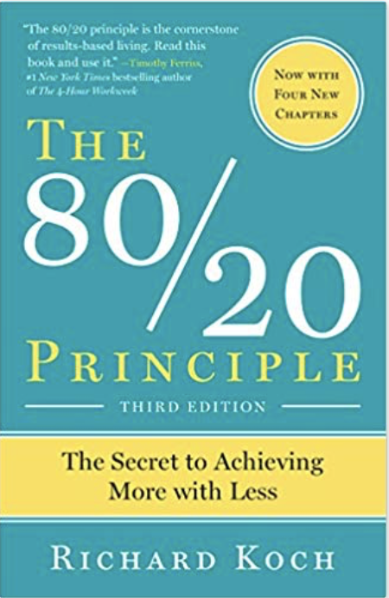

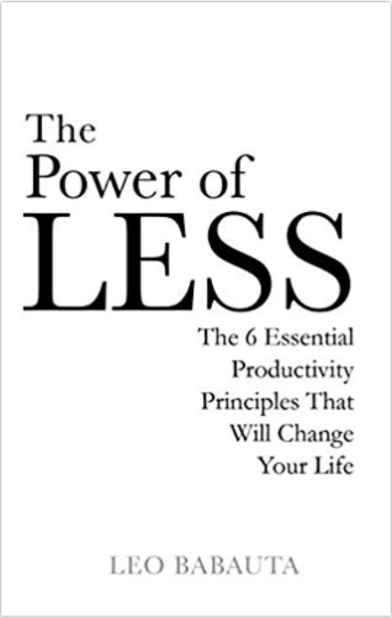
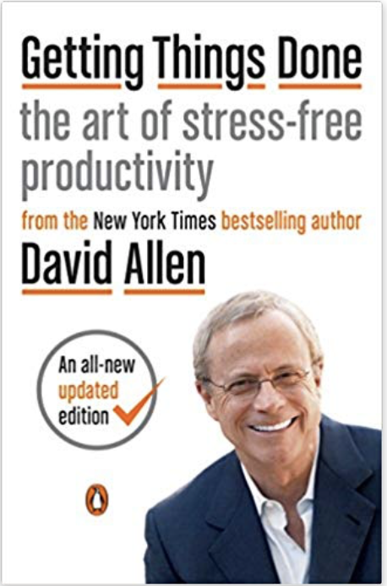
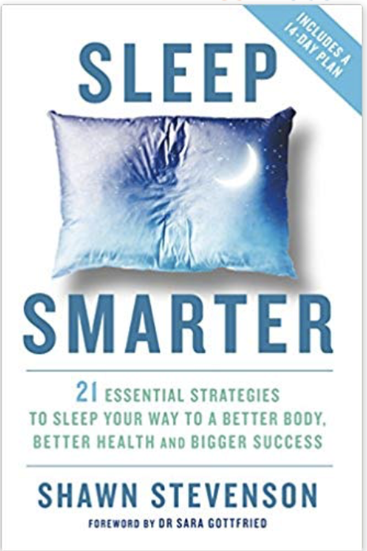
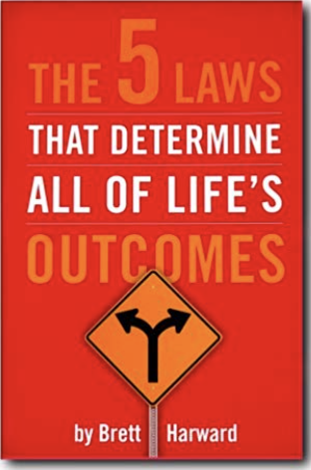
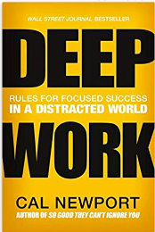
Books on Productivity:
Living the 80/20 Way (Richard Koch)
The 80/20 Principle (Richard Koch)
The Power of Less (Leo Babauta)
Getting Things Done (David Allen)
Sleep Smarter (Shawn Stevenson)
The 5 Laws That Determine All of Life's Outcomes (Brett Harward)
Deep Work (Cal Newport)
Notes:
https://www.surveymonkey.com/r/TMProductivity
[ANTHONY/INSTRUCTOR 1] [BEGINNING SCRIPT]
I would like to review the books mentioned in this session. ​
If you want to learn about the 80/20 Principle, read Richard Koch’s books, and I highly recommend that you read the one called “Living the 80/20 Way” first. Of his books on the 80/20 Rule, “Living the 80/20 Way” is much more simplistic and powerful, as some of his business-oriented books get more complicated. ​
“The Power of Less, The Six Essential Productivity Principles That Will Change Your Life” by Leo Babauta, is a dynamite book. In fact, the next book, “Getting Things Done, The Art of Stress Free Productivity” by David Allen is also one of the most well known books on productivity, but it's very complex and Babauta actually wrote “The Power of Less” in response to Allen’s book to provide a more simplistic way to implement Allen’s ideas. ​
And then the last three are “Sleep Smarter” by Shawn Stevenson, “The Five Laws That Determine All of Life's Outcomes” by Brett Harward. This is another great book that if you follow the real simple laws, it can dramatically change the course of your career and your life. ​
And lastly, “Deep Work” by Cal Newport. Cal Newport is a professor at Georgetown University. He's been one of the pioneers of this idea that focus is a commodity these days and has researched different ways that we can really do deep, focused work.​
If you could only read one of these, go with Living the 80/20 Way - it’s a game changer.​ Last I checked, it was actually out of print, but I believe you can still find used copies on Amazon. [CLICK]

Slide 53
Summary
Efficiency versus Effectiveness
Three Rules to Productivity
    Stay Organized
    Remain Focused
    Reduce Stress
Work –Life Balance
Notes:
https://www.surveymonkey.com/r/TMProductivity
[INSTRUCTOR 1/ANTHONY] [VIDEO OFF]
Quick summary. We talked about [click] efficiency versus effectiveness, maybe the most important item we discussed.
We covered the [click] three rules to maximizing productivity, [click]stay organized, [click]remain focused and [click]reduce stress.
Lastly, I just discussed [click] work-Life balance and the importance of defining what it means to you. ​[CLICK]

Slide 54
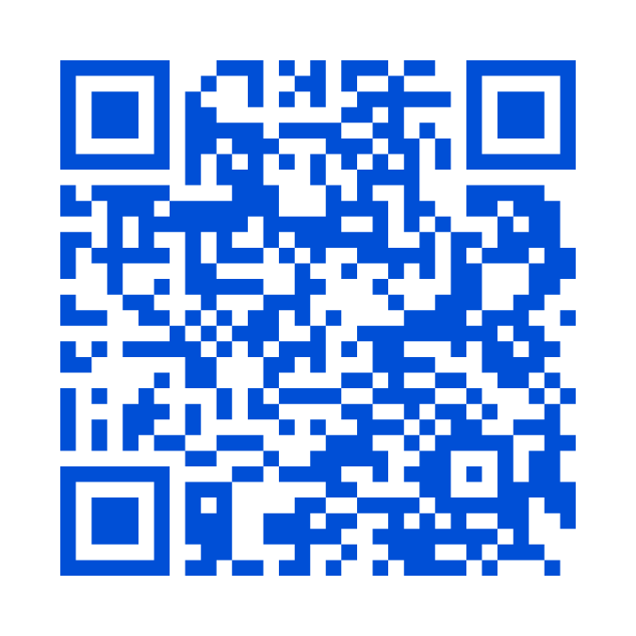
QUESTIONS / DISCUSSION
Time Management and Maximizing Productivity for AEC Professionals
Presented for:
Notes:
https://www.surveymonkey.com/r/TMProductivity
​​[INSTRUCTOR 1/ANTHONY] [VIDEO ON]
Now I’d like to open it up for questions, comments or thoughts you have on the material in today’s session.​
[TAKE QUESTIONS]​
I have a question for you as we wrap up. What strategy from today’s session is one that you plan to try in the next week or so to improve your productivity? Go ahead and chat them in.
Please work on those transfer assignments.​

